Slide 1
Quality Assurance in Child and Family Support in Europe Policy lessons for evidence-informed decision making
Brussels, 30th September 2024

Slide 2
Quality Assurance in Child and
Family Support in Europe Policy lessons for evidence-informed decision making
Word of welcome from the European Family Support Network
Lucía Jiménez and John Canavan
Chair and Vice Chair of EurofamNet
In behalf of EurofamNet

Slide 3
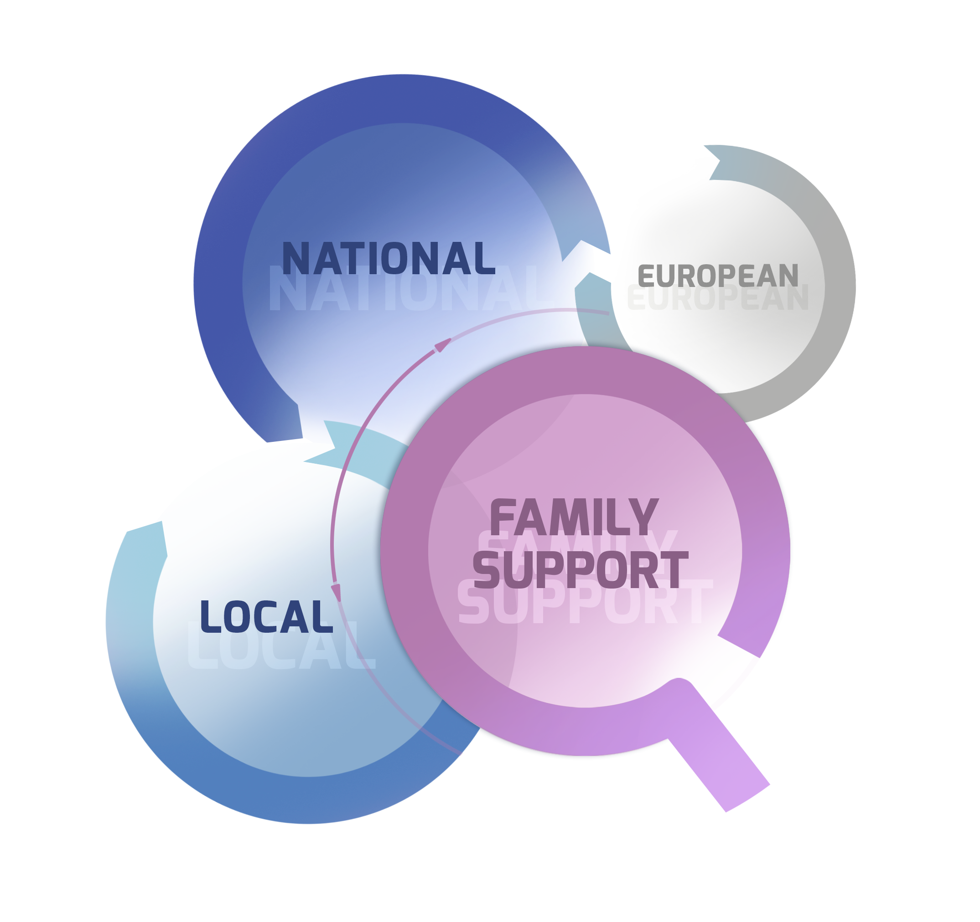
The European Dimension of Quality Family Support
eurofamnet.eu
The mobilisation and provision of resources and support for the purpose of sustaining and enhancing family roles and assets, and promoting the well-being and capabilities of family members, including children and parents.
Family support includes a range of resources and support provided by informal networks, semi-formal community groups and formal provision and services (Churchill et al., 2024)
Notes:
-From the Convention on the Rights of the Child in 90’s, the family has been recognised as the vehicle trough those rights and wellbeing can be guaranteed and national-level responsibilities on supporting parents and caregivers were stablished and local authorities have been encouraged to provide support to families. Children do not live isolated, but in families and communities.
-From the UNCR, EU policies and regulations on children and Young people have been developed mediated by family, some of them with explicit naming of family and some not, but how policy translates into provision is largely fragmentated
-Challenge in providing quality family support

Slide 4
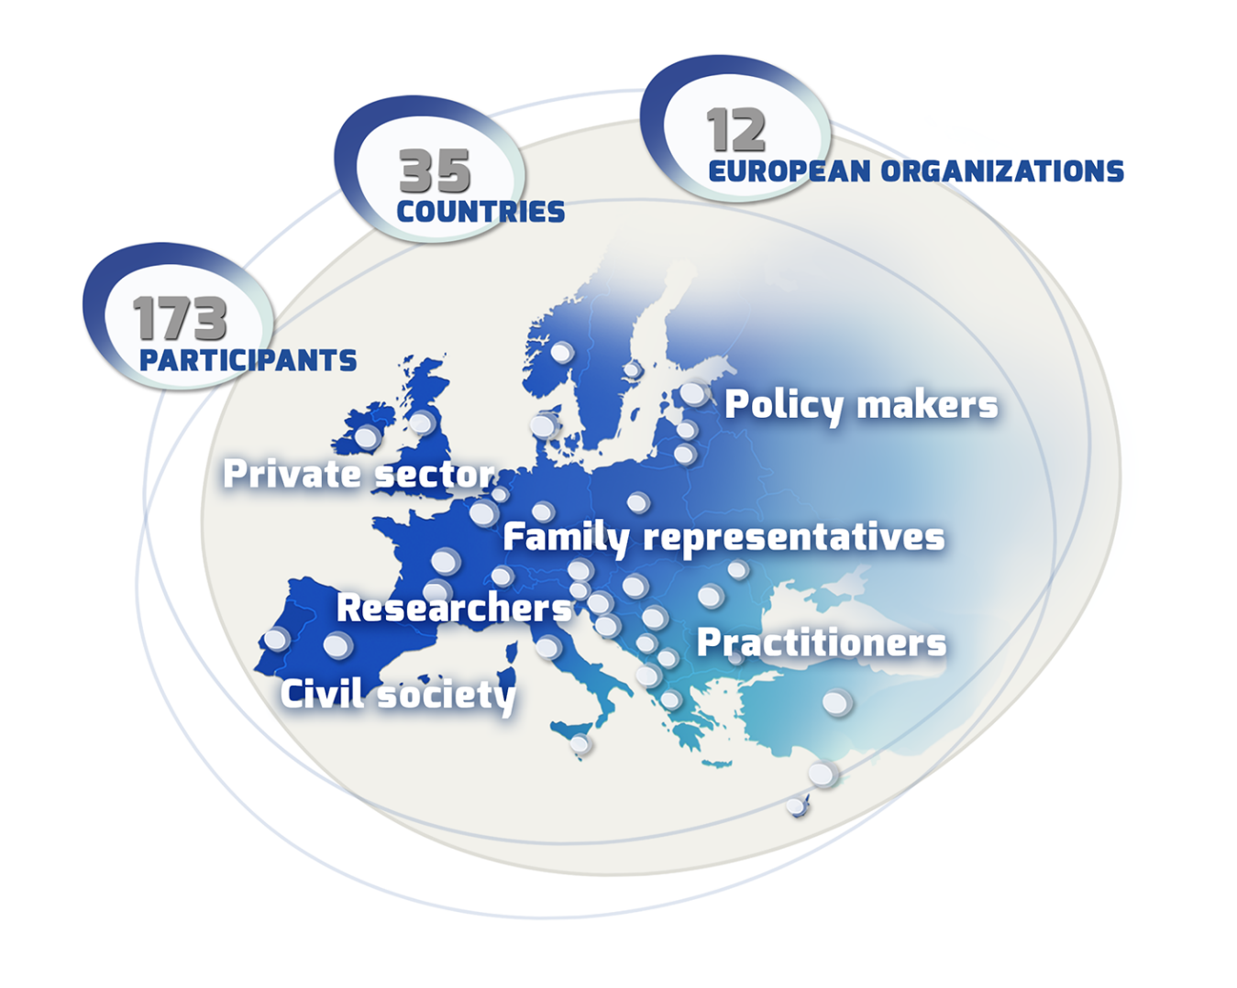
The European Family Support Network
eurofamnet.eu
Support rigorous, bottom-up, and interdisciplinary research focused on developing the field of Family Support
Making quality family support a right for all children
Advocate for an evidence-informed child and family support policy and practice
Notes:
A pan-European family support network addressing some of the research challenges in family support at European level
-by building collaborations between researchers, and practitioners, policy-makers, and children and families’ representatives.
from 2019, EurofamNet is operating in the COST framework
supporting rigorous, bottom-up, and interdisciplinary research focused on developing the field of Family Support
_making quality family support a right for all children
_that requires advocating for an evidence-informed child and family support policy and practice

Slide 5
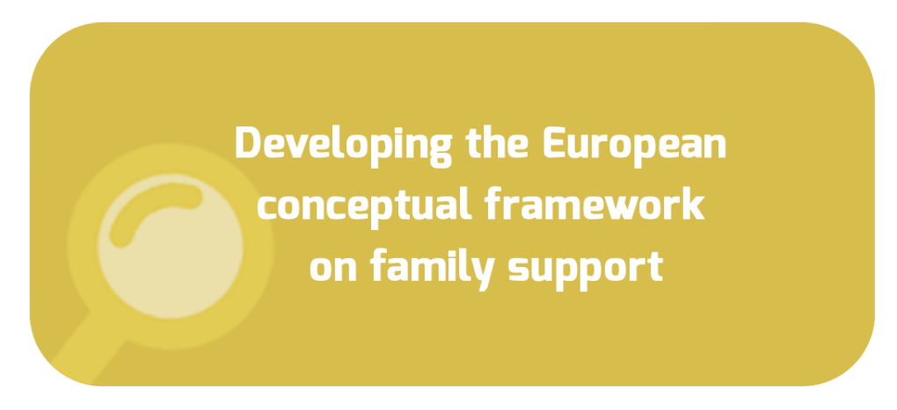
Family Support Research Agenda
eurofamnet.eu
Coord. Devaney, Churchill & Abela
Coord. Zegarac & Mesl
Coord. Byrne & Pecnik
Notes:
-There are three key areas covered by EurofamNet that currently constitute research challenges in family support agenda at European level:
-First, is the need for moving forward on the conceptualisation and delivery of family support in Europe, by analising family conceptualization and provision in Europe, and examining new-realities and targeted needs.
-Second, the need to provide more advanced evidence-based and culturally informed approach that offers practitioners effective programmes and practical toolkits relevant for specific family contexts
-And advance a shared framework on skills qualification for family support workforce in the 21st century.
EurofamNet is progressing on those challenges following the methodology:
A bottom-up process: We are seeking regional and national solutions, by engaging the existing national structures and cooperating with them systematically during the life of the project.
Dialogical style: Because the network aims to make a difference to children, young people and parents, it ensures that all relevant voices are heard, and listened to, in order to realise genuinely child and family-focused policy and practice.
Double-layered structure: The project aims to establish a supranational network that make possible policy engagement between the European level and the local/regional/national levels, with mutual influence between them by supporting an ongoing iterative dialogue.
-Specific group across: Policy & practice group

Slide 6
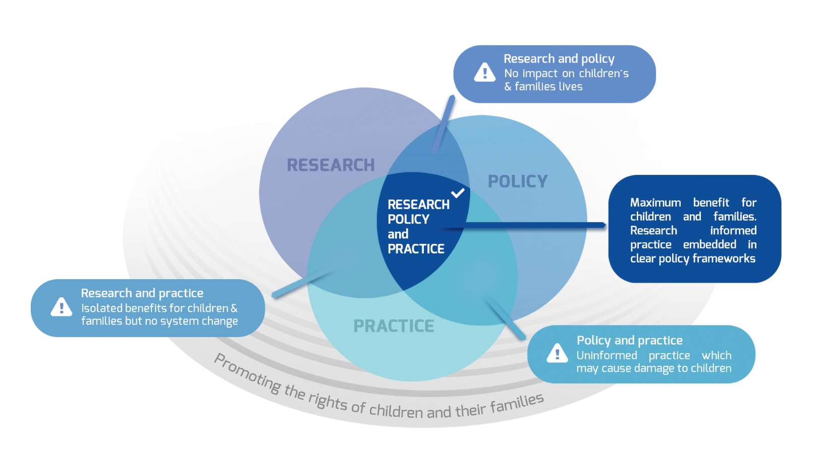
Evidence-informed child and family support policy and practice
eurofamnet.eu
Notes:
-In order to make this research relevant to make a real difference in children and families lives we need to advocate for an evidence-informed child and family support policy and practice
-In order to reach this ambitious objective, from the foundations EurofamNet has grounded her research in the intersection with poliy and practice:
_Policy and practice / _Research in practice / _Research and policy
_In an intersection of a research informed practice embbeded in clear policy frameworks
_Starting from the rights of children and families as the basis

Slide 7
A real difference in children and families lives
eurofamnet.eu
Quality Assurance in Child and Family Support in Europe
Notes:
-The next step: addressing the challenge of implementation
-That is not new in our discipline. We have realized in the last decade that the way we produce evidence has to guarantee ecological validity
-Learnings to guarantee quality assurance in family support provision
-Title of today’s conference

Slide 8
Policy lessons for evidence- informed decision making
eurofamnet.eu
European Child Guarantee – an evidence-based policy making
Quality family-based care for integrated child protection systems in Europe
A quality assurance model for integrated child and family care in Europe and current situation in 19 countries
Policy guidelines for evidence-informed decision making in child and family support provision
The policy and practice perspective on learned lessons for evidence-informed decision making
Notes:
-Specific focus on policy lessons
-Agenda
-Add concluding remarks

Slide 9
Quality Assurance in Child and
Family Support in Europe Policy lessons for evidence-informed decision making
Word of welcome from the European Family Support Network
Lucía Jiménez and John Canavan
Chair and Vice Chair of EurofamNet
In behalf of EurofamNet

