Slide 1
Quality Assurance in Child and Family Support in Europe Policy lessons for evidence-informed decision making
Brussels, 30th September 2024

Slide 2
Quality Assurance in Child and
Family Support in Europe Policy lessons for evidence-informed decision making
EC RECOMMENDATION: Integrated child protection systems and
Quality family-based care
Chrisoula Arcoudis
DG Justice and Consumers, Rights of the Child Team

Slide 3
Commission Recommendation on Integrated Child Protection systems
Commission Recommendation on Integrated Child Protection Systems
EU Strategy on the rights of the child
Alignment with EU institutions calls: EP, Council, Committee of Regions
Objective: Fight all forms of violence against all children Calls on Member States to strengthen their national child protection systems :
Strong and responsive measures
Working in an integrated and coordinated way
Promoting child protection as a global priority
Making use of EU tools (legislation, policies, funding)
Cross-policy initiative on child protection

Slide 4
Documents
Documents
Delivering on the EU strategy on the rights of the child
Factsheet
Comprehensive package on integrated child protection
Commission Recommendation on integrated child protection systems
Communication, Annex with existing relevant EU support (legislative, policy actions, funding)
Staff Working document
Consultation
1,095 children via the EU Children’s Participation Platform
FRA Mapping of national child protection systems
Call for Evidence and Open Public Consultation
EU Network for Children’s Rights (Member States, international and civil society organisations)
ISC, ISG on children’s rights and JUST contact group

Slide 5
EC Recommendation on ICPS:
Strengthening national child protection systems
Converging priorities towards an integrated approach to child protection for EU Member States
UN (CRC) : UNICEF Recommendation Child Protection Systems Strengthening .pdf (unicef.org)
COUNCIL OF EUROPE (ECHR) : Recommendation Policy Guidelines on Integrated National Strategies for the Protection of Children from Violence for states striving to adopt a holistic approach to violence against children and to guarantee their children a childhood free from violence.
EU (CFR): Commission Recommendation on integrated child protection systems
Pulling together EU legislation and policies through mainstreaming ICPS
Victims’ Rights Directive
Directive on combating violence against women and domestic violence
Directive on Trafficking in Human Beings
Directive on Child Sexual Abuse and Exploitation

Slide 6
EC Recommendation on ICPS:
Strengthening national child protection systems
Why an integrated approach against violence?
Violence against children takes many forms and can occur in almost all settings of a child’s life. The most devastating types of violence are often hidden from public view.
Sexual orientation, gender identity and belonging to a marginalized social or ethnic group also heightens a child’s chance of suffering violence. These children, often remain invisible to child protection systems.
Violence against children is multidimensional, it presupposes a combination of factors which must come into play for violence to cease, including tackling its root causes.
An integrated approach puts in motion a ‘zero tolerance’ to violence

Slide 7
EC Recommendation on ICPS:
Strengthening national child protection systems
What is an Integrated Child Protection System?
A system where child protection mechanisms are:
Coherent and comprehensive across a range of disciplines (cultural, psychological, behavioural, socio economic) and across all sectors (education, health, law enforcement etc)
Timely and responsive support -for children facing co-occurring protection needs including early identification, judicial intervention, setting minimum standards and follow-up protocols
Operational coordination and governance, including monitoring of measures across central government, regional and local authorities across different layers of competences, and between government and civil society to identify gaps and emerging needs.
Inclusive of all children protection needs across all domains of their lives
ALL actors with responsibility for child protection, including children themselves, should have clear roles are part of a knowledge sharing system

Slide 8
EC Recommendation on ICPS:
Strengthening national child protection systems
Integrated
Child
Protection
System
Moving away from:
working in silos
insufficient prevention policies
absent early identification systems
weak and fragmented (including psychosocial) support
lack of coordination and information flow on cases
issue based programming and funding
Towards Integrated child protection systems where all elements and components work in a more coordinated, holistic, sustainable and long-term system-wide approach, addresses the wider vulnerabilities of children and their families and includes preventative strategies through child centred budgeting.
Domains where children need to feel safe: school, home, online, public and community based spaces, institutions, in court proceedings, on the move (migration), cross border situations
Types of violence children face: sexual abuse, mental health, poverty, discrimination and bullying, trafficking, early marriage,
Targeted child violence vulnerability: girls, migrant and asylum seeking children, LGBTQI+, Roma children, disabled children, homeless children, children in institutional care.

Slide 9
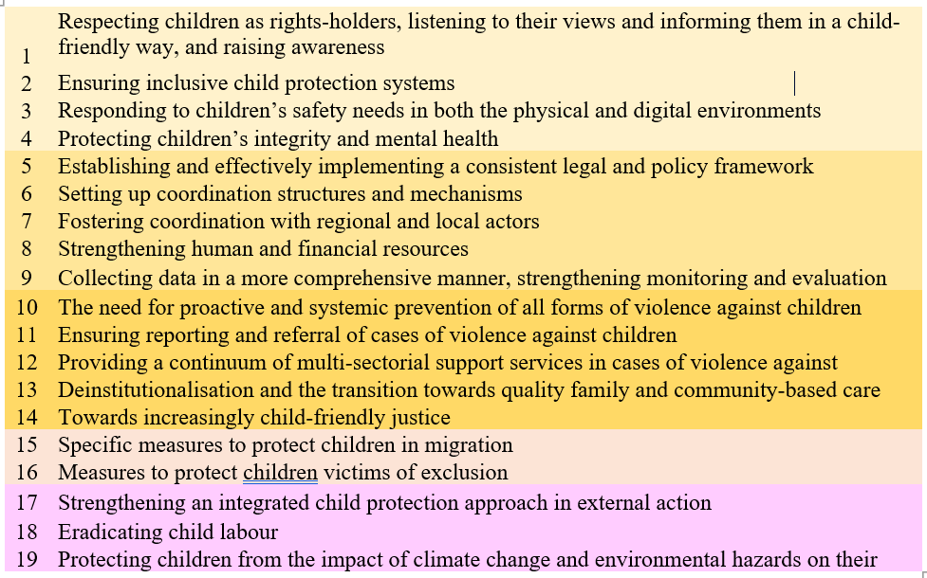
EC Recommendation on ICPS:
Key Guiding Principles
Key Guiding Principles
INTEGRATED OPERATIONAL PRINCIPLES
CHILD PROTECTION PRINCIPLES

Slide 10
EC Recommendation on ICPS:
Strengthening national child protection systems
EC Recommendation on ICPS:
Strengthening national child protection systems
All domains of violence
Home
Family
Schools
Public and community settings
Institutions including judicial and penal settings
Online
Cross border situations
On the move
Environment
ICPS OPERATIONS
Legislative and policy frameworks
Coordination and governance of actions and actors
Continuum of prevention, protection, safeguarding and rehabilitation services
Accountability, data and evidence
Child, family and community engagement
Human and financial resources
All forms of violence
Trafficking and child labour
Discrimination
Domestic violence
Sexual abuse and exploitation
Emotional and psychological
Bullying and cyber abuse
Poverty and neglect
Corporal punishment

Slide 11
Focus – General framework of integrated child protection systems
EC Recommendation on ICPS:
Strengthening national child protection systems
National plans to fight violence against children:
embrace a leadership and accountability role in child protection
ensure that the laws are being implemented
articulate priority areas and specific entry points for ICPS and develop a menu of interventions in each priority area
identify funding and EU support mechanisms to move their interventions towards a comprehensive ICPS
establish coherent data and evidence mechanisms to close gaps against ICPS benchmarks, program impact pathways
ensure child, family and community participation
Identify a working method with all actors in delivering child protection services

Slide 12
Focus – Continuity of comprehensive and coordinated services to address children’s needs
EC Recommendation on ICPS:
Strengthening national child protection systems
FOCUS on children and families
RECOMMENDATION recognises:
that families are primary carers
Calls on Member States
to promote an interdisciplinary approach involving families
to provide parenting and family support, providing the necessary conditions to prevent family separation, in the best interests of the child.
to take all measures to ensure the prioritisation of family-based and community-based care for children when placing children into alternative care
Example of key resources
European Child Guarantee
Guidance on independent living and community inclusion (planned for 2024) complemented by Framework for social services of excellence for persons with disabilities
European Social Fund+, European Regional Development Fund,
Capacity-building under Erasmus+ to support the shift from institutions to person-centred, community-based inclusive services

Slide 13
Focus – Continuity of comprehensive and coordinated services to address children’s needs
EC Recommendation on ICPS:
Strengthening national child protection systems
FOCUS on children and families
RECOMMENDATION recognises:
the unequal access to key services for children and their families
Calls on Member States to prevent and combat social exclusion by guaranteeing effective access of children to key services, such as education, healthcare and housing
Example of resources
European Pillar of social rights, European Child Guarantee, European care Strategy
Council Recommendation on High quality early childhood education and care systems
Victims’ Rights Directive, Proposed Directive on gender-based and domestic violence
Child Helpline and Missing Children hotline
European Social Fund+, European Regional Development Fund, Common Provisions Regulation, Recovery and Resilience Facility
Technical Support Instrument, CERV (Daphne call)

Slide 14
Focus – Continuity of comprehensive and coordinated services to address children’s needs
EC Recommendation on ICPS:
Strengthening national child protection systems
FOCUS on children and families
RECOMMENDATION recognises:
that children with disabilities need quality family and community-based care
Calls on Member States to support children with disabilities and their families as early as possible to prevent the placement of children with disabilities in institutions
Example of resources
European Social Fund+, European Regional Development Fund, Common Provisions Regulation, Recovery and Resilience Facility human capacity and infrastructure development, equipment and access to mainstream non-segregated services, and the shift from institutional to non-residential family- and community-based services
Technical Support Instrument, CERV (Daphne call)
European Child Guarantee supports ‘de-institutionalisation of children, and [of] quality community-based or family-based care.
European care strategy notably promotes the opportunities available at EU level to support capacity-building, for instance under Erasmus+, which can in particular support the necessary training and capacity-building for the shift in services provision from institutions to person-centred, community-based inclusive services.

Slide 15
Focus – Continuity of comprehensive and coordinated services to address children’s needs
EC Recommendation on ICPS:
Strengthening national child protection systems
FOCUS on children and families
RECOMMENDATION recognises:
the needs of children without parental care
Calls on Member States
to promote national strategies and programmes to accelerate deinstitutionalisation and the transition towards quality family- and community-based care services for children without parental care
to address the issue of lack of foster families, in particular for children in precarious situations or with complex needs or with a view to keeping siblings together. Appropriate resources should notably be allocated for community- or family-based care.
Example of resources
European care strategy
Council Recommendation on longterm care
Strategy for the Rights of Persons with Disabilities
European Social Fund Plus (ESF+) and the European Regional Development Fund (ERDF) a
2021-2027 Common Provision Regulation

Slide 16
Focus – Continuity of comprehensive and coordinated services to address children’s needs
EC Recommendation on ICPS:
Strengthening national child protection systems
FOCUS on children and families
RECOMMENDATION recognises:
the needs of children to be re unified with their families
Calls on Member States to build national integrated child protection systems that are ready to face the diversity of situation of children in migration (unaccompanied children, victims of trafficking, children asking for international protection or reunifying with their family and children integrating in the local community and accessing the general services).
Example of tools
Pact on Migration and Asylum
Action plan on Integration and Inclusion 2021-2027
Temporary Protection Directive
European Guardianship Network
2017 Communication on the protection of children in migration
FRA, Establishing national independent mechanisms to monitor fundamental rights compliance at EU external borders (guidance)
Funds: AMIF, ISF

Slide 17
Focus – Continuity of comprehensive and coordinated services to address children’s needs
EC Recommendation on ICPS:
Strengthening national child protection systems
FOCUS on children and families
RECOMMENDATION recognises:
that corporal punishment is a form of violence
Calls on Member States to ban corporal punishment and work with support services for children and their families providing families with the necessary social protection and support to ensure children’s development and well-being, including through effective prevention of such punishment and early intervention.
Example of tools
Eliminating all corporal punishment of children requires a combination of explicit law reform, protection and prevention policies, and other, primarily educational, measures to move societies on from accepting violent and humiliating punishment
Article 19 of the UN Convention prohibits all corporal punishment of children
Council of the European Union, in its Conclusions on the EU strategy on the rights of the child
European Child Guarantee
The Council of Europe recommendation on policies to promote positive parenting,

Slide 18
Focus – Continuity of comprehensive and coordinated services to address children’s needs
EC Recommendation on ICPS:
Strengthening national child protection systems
FOCUS on children and families
RECOMMENDATION recognises:
that violence in the home -domestic violence is a form a violence that has long term consequences for children
Calls on Member States to ensure that social services provide assistance and support for child victims, their family with special support and early intervention programmes
Example of resources
European Pillar of social rights, European Child Guarantee, European care Strategy
Council Recommendation on High quality early childhood education and care systems
Victims’ Rights Directive, Proposed Directive on gender-based and domestic violence
Child Helpline and Missing Children hotline
European Social Fund+, European Regional Development Fund, Common Provisions Regulation, Recovery and Resilience Facility
Technical Support Instrument, CERV (Daphne call)

Slide 19
Focus – Continuity of comprehensive and coordinated services to address children’s needs
EC Recommendation on ICPS:
Strengthening national child protection systems
FOCUS on children and families
An ICPS Approach in National Planning: Children in institutional care
Rethinking the CP issue from an ICPS approach:
Key questions
Is the issue articulated in the national CP system?
Is the issue reflected in legislative, policy , strategy and implementation mechanisms?
Is there a lead ministry/agency?
Who are the key actors, stakeholders and sectors involved in the issue? Is there intra and intersectoral coordination?
Are there standard operating procedures and protocols in the services?
Are there case management and referral mechanisms?
Is the issue part of the accountability and oversight system?
Is there regular monitoring and reporting of the issue carried out by national or local agency?
Is there an availability of qualified service workforce ?
What is the source of funding?
Are there mechanisms for child engagement/participation?
Is there an independent complaints mechanism for children?
Is there community engagement?
Are there data collection mechanisms? Is this data used in planning, programming and policy design?
Realigning for ICPS outcomes
Coordination and governance of services of disabled children in institutional care
• Operationalise the CPS at different levels to include the issue
• Invite development partners to participate in the CPS at different levels.
• Review and revise guidelines for establishing agreements and coordinated project development with partners
• Ensure interventions and resources are aligned with the system core recommendations, national plan of action and workforce strengthening guidelines
• Develop a Child Protection Information Management System (CPIMS) which include children in institutional care
• Strengthen reporting, information sharing and learning initiatives
•Adopt and use good practices of deinstitutionalisation of disabled children, to strengthen the transition from institutional care to services providing support in the community.

Slide 20
Focus – General framework of integrated child protection systems
EC Recommendation on ICPS:
Strengthening national child protection systems
National plans to fight violence against children: family-based care
Coordination structures & mechanisms (across sectors, competent authorities at national/regional/local level, public/private) , CSO
Quality frameworks, trainings, protocols and safeguards for professionals, those working with children
Data collection, monitoring violence against children and child protection systems
Prevention: preventive support, early identification, warning
Safe and inclusive environment in education: fight discrimination, respond to specific vulnerabilities
Support services to children and families, recommending to ban corporal punishment
Complaint and reporting mechanisms: accessible, safe, confidential, child-friendly, well-publicised
Multi-sectorial support services: assistance and support for child victims, families and caregivers

Slide 21
EC Recommendation on ICPS:
Strengthening national child protection systems
Focus – Protecting children in migration
EC Implementation Plan of the Recommendation on ICPS
3 Key Actions:
Supporting MS develop and strengthen their National plans through technical assistance, capacity building, promoting a culture of ICPS expertise;
Providing a Toolbox that will assist Member States and other stakeholders navigate through the EU funding opportunities when planning ICPS interventions and to be able to benchmark progress;
Promoting ICPS approach in synergy with other cross cutting child protection priorities of EU laws, policies, funding programmes.

Slide 22
Quality Assurance in Child and
Family Support in Europe Policy lessons for evidence-informed decision making
Thank you very much for your attention!
Quality family-based care for integrated child protection systems in Europe
Chrisoula Arcoudis
DG Justice and Consumers, Rights of the Child Team

