Slide 1
Quality Assurance in Child and Family Support in Europe Policy lessons for evidence-informed decision making
Brussels, 30th September 2024

Slide 2
Quality Assurance in Child and
Family Support in Europe Policy lessons for evidence-informed decision making
A quality assurance model for integrated child and family care in Europe
and current situation in 19 countries
Lucía Jiménez & Mª José Rodrigo
WP1 Project Coordinators in behalf of
Sofía Baena, Sonia Byrne, Ana Catarina Canário, Orlanda Cruz, Carmel Devaney, Jean Grasmeijer, Victoria Hidalgo, Metin Özdemir, Nina Mešl, and Cristina Nunes

Slide 3
Rationale for an European Quality Assurance Model in Family Support
eurofamnet.eu
Child and family wellbeing is at the forefront of European social frameworks and policies, giving governments a responsibility to support them.
Social policy emphasizes the adoption of EBP as a principle for investment, informed decision-making, and transferability of quality professional practices.
Policy emphasis on quality assurance in social and care services has been established, but a gap exists in the implementation and lack of specificity of a model tailored to the field of family support and its adequate measurability.
Consensus on a quality assurance model and its application at the country level can inform the potential existence of inequalities in quality family support across Europe and ways of improvement.
Notes:
-The current vision on children and families as subjects of rights places their interests and wellbeing at the forefront of social policies and gives governments the responsibility to support parents in the exercise of their parental functions. To materialize this shared recognition, a common family support umbrella at a European level has been promoted, beyond which family and parenting policies can be included under common goals and values of states’ parties, including: Pillar of Social Rights, Child Guarantee, Friendly Social Services Recommendation, Positive Parenting Recommendation, European Care Strategy and more recently integrated child protection systems in the best interests of the child
-Policy emphasis on quality asurance at the European level as established in all this frameworks, and as developed in the Voluntary European Quality Framework for Social Services and in specific areas (long term, disabilities)
-In spite of the concern of the European Union in promoting quality assurance in social services, the core policy of the European Union on this matter, the EU Voluntary Framework on Quality in Social Services (2010), has shown a limited impact in terms of implementation (European Social Network, 2023). According to this, the European Commission has recently encouraged states to increase quality assurance processes in social and care services (Directorate-General for Employment, Social Affairs and Inclusion of the European Commission, 2022).
-Second, despite the concern of the European Union on quality provision, the existing quality frameworks are related to specific areas in social and education care (e.g., the EU Framework on Social Services of Excellence for persons with disabilities, 2024). However, there are no clear advances on the development of a framework for quality family support that involves objectives, principles, standards as well as measurable indicators: only development at the principles level
-This gap exists because we lack a model, for this reason, our objective

Slide 4
QA[4]EuroFam Objectives
eurofamnet.eu
To develop a comprehensive, integrated, and measurable approach of quality family support across European countries
using a Quality Assurance Protocol
To apply agreed principles, quality standards and measurable indicators aimed at improving outcomes in wellbeing and quality of life in children, youth, and families across Europe
To create a national and local led collaborative scenario that identifies challenges, strengths, and need for improvements in the family support services at the country level
To develop recommendations at the national and the European policy level that promotes high quality, evidence-based, and culturally sensitive family support provision
Notes:
Is in this framework that the QA[4]EuroFam Project is developed
The general aim allow to reach these specific objectives

Slide 5
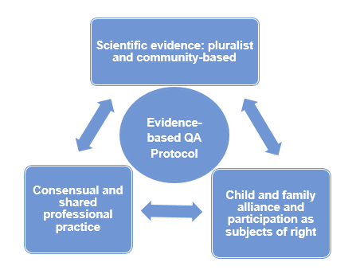
Sources of evidence for a Family Support Quality Assurance Model
eurofamnet.eu
Translational, relational and
collaborative efforts

Slide 6
Quality Assurance Model in Family Support
eurofamnet.eu
Application field
Objectives
Principles
Quality standards
Measurable indicators
Outcomes
Quality Assurance Protocol

Slide 7
Quality Assurance as a System of Embedded Systems
eurofamnet.eu
Family support evidence system
Family support provision system
Family support practice system

Slide 8
Family Support Practice System
eurofamnet.eu
Practice system
Family-profesional relationships:
Rights, needs and strenghts orientation
Alliance, collaboration and responsiveness
Ethics and confidentiality
Service organisation:
Governance and leadership
Transparent and accountable organization Intervention models & modalities Implementation
Programmes/interventions:
Use of evidence-based programmes/interventions
Feasibility and continuity

Slide 9
Family Support Provision System
eurofamnet.eu
Provision system
Policies and associated guidelines and legislation:
Supportive policies and associated guidelines and legislation
Competences at national and regional levels
Articulation into public, non-profit and pro-profit agencies and social entities
Characteristics of services: Financial support and work-family conciliation measures
Accessible, responsive, and needs-led, broad, and inclusive provision
Continuum of support, sustainable and adequate
Coordination mechanisms
Person-centered approach addressing the family system
Quality workforce in family support

Slide 10
Family Support Evidence System
eurofamnet.eu
Structures: Collaboration between policy makers, researchers, professionals Entities that promote the knowledge mobilization Engagement of support providers, stakeholders, children-adolescent and families to advocate for participation in quality family support
Implementation: Efforts to evaluate the quality of the service
Recognition of endorsing best practices guidelines
Training of professionals on best practices guidelines
Dissemination among professionals, families, and society at large
Relational translational efforts : Involving scientific evidence, consensual practice, and families as rights owners Consensual guidelines with best practices and effective approaches Consensual guidelines with interprofessional competences
Evidence system

Slide 11
Quality Assurance Protocol Development
eurofamnet.eu
Documentary analysis of European regulations, quality frameworks from relevant European-level bodies, and previous empirical efforts
Expert panel integrating lessons learned from EurofamNet
Development of 33 principles, 47 quality standards and 68 measurable indicators organised in the three systems
Two-rounds Delphi study with 31 experts from the broader network including researchers and stakeholders from the policy and practice sphere
Final Quality Assurance Protocol with 21 principles, 28 quality standards and 29 indicators organised in the three systems
Notes:
-Highlight the rigorousness of the process: aligned with Europe. expert panel integrating lessons learned from EurofamNet, Delphi methodology addressing broader network, remarks from policy & practice stakeholders tailored to different audiences.
-First attempt to develop a Quality Assurance Model in family support at the European level: from documentary analysis of European regulations, quality frameworks from relevant European-level bodies, and previous empirical efforts: HEALTH. No indicators
-Delhpi study: rigurous assessment including quantitative analysis of coherence, clarity, relevance...
_There were positive results, but
-Reduction for feasibility and affordability purposes with no loosing

Slide 12
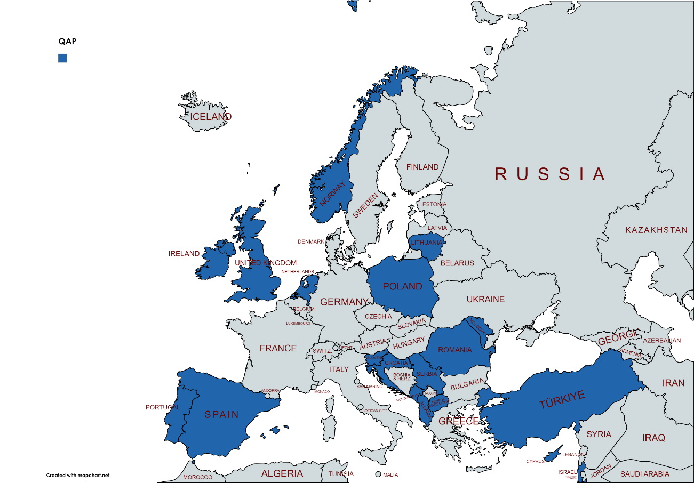
Quality Assurance Protocol Implementation
eurofamnet.eu
Self-assessment process led by National Working Groups
Multi-disciplinary, cross-sectorial & multi-agency partnership
Guarantee for engagement, reliability and sustainability
Opportunity to create local and global systemic transformation
19 National Working Groups
N = 283 participants
M = 14.89 (SD = 10.57)
Notes:
-In this year we have implemented the QAP in 19 countries
-For this purpose, we have strenghtened the double-layered structure of the network by Empowering national working groups
-In each country we had mapped the national, regional and local structures for public services, practitioners representatives, NGOs and academic/researchers institutions.
_Integration of key agents like national coordinators of the European child guarantee, not only from SS.SS. but from education, justice
_Trough a co-production approach that is inclusive in terms of disciplines, agents, sectors… but particularly including the voices of children and families in a transformative way as never done before
19 National Working Groups, involved a total of 283 participants (M = 14.89 members; SD = 10.57). With a range from 3 to 44 members
-National working groups made possible the development of a collaborative, translational and dialogic process that allows self-diagnosis and self-guided decision making, being respectiful with countries diversity. Not a single modle, but several models.
_It is a guarantee for engagement, for reliability of the information and for sustainability
_This gives the opportunity to create systemic transformation: to implement this in formal structures: enrich the evidences ecosystem at formal level. empowers a shared culture for evidence, promotes social innovation, and motivates systemic change

Slide 13
Quality Standards in the Practice System
eurofamnet.eu
Notes:
-Publication after conclusions derived from this evento: QAP and report: with European level data and data for each country
-Global picture of main European-level results sharing some data
(#1.1) The services take into account the best interest of the child and respect the rights and developmental needs of children and youth (and their families) when taking action
This is a specific indicator for: Frame the services objectives from the standpoint of rights and developmental needs of children, youth and families
As well as guarantee of confidentiality is one for complying with international ethical principles
-Four level of achievement
1 = not at all (the indicator is not present in the services)
2 = a little (isolated efforts - some elements of the staff implement the indicator in most of the services)
3 = the indicator is established in the institution’s policies/guidelines but its implementation is not monitored in most of the services
4 = totally (the indicator is established in the institution’s policies/guidelines and its implementation is frequently monitored in most of the services)
-All of them between 2 and 3 in terms of average, moderate achievement
-Except for best interest, confidentiality
-Some variability between countries as expressed by the standard deviation

Slide 14
Quality Standards in the Provision System
eurofamnet.eu
Notes:
-Higher variability intercountry
-Coordination and professoinal training reaching the highest scores, although also accumulating highest variabiblity
-Lowest scores: economic, family-friendly, person-centered and adquate funding, wit moderate to high variability

Slide 15
Quality Standards in the Evidence System
eurofamnet.eu
Notes:
-Reaching the lowest scores, any indicator is reaching number 3 as an average
-Particularly remarkable quality assessment in services (internal no consensual)

Slide 16
Differences by Sector
eurofamnet.eu
Notes:
-Differentiation by sectors, particularly in practice system
-Similar in some aspects like evidenc-ebased approach
-Larger differences in way of working

Slide 17
Prioritisation in the Practice System
eurofamnet.eu
Strengths
Areas for improvement
Notes:
-Asking NWGs to prioritise what was consider strenght or área for improvement
-Strengths to identify Good practices
-Areas for improvement to identify barriers, facilitators, training needs
-Not a plan for action, but Recommendations to guide action

Slide 18
Prioritisation in the Provision System
eurofamnet.eu
Strengths
Areas for improvement
Notes:
Higher variability also expressed here: No that higher percentages
Broad accesible supports
-Strengts: inclusinveness cultural, profesional training
-

Slide 19
Prioritisation in the Evidence System
eurofamnet.eu
Strengths
Areas for improvement
Notes:
Lowest scores does not surprise a few strenghts by 1/3 countries
A lot of áreas for improvement: signifying the priorization of this system

Slide 20
Final Remarks
eurofamnet.eu
First attempt to develop a Quality Assurance Model in family support at the European level: consensual, comprehensive, cross-sectoral and measurable.
Rigorous self-assessment process through a national-led collaborative scenario to identify strengths and experiences of success, needs for improvement and recommendations, facilitators, barriers, and training needs.
Rights-based approach has permeated family support practice & support provision, although economic support and novel models for practice have not. Evidence system with largest room for improvement is recognised as a key priority.
Between country and cross-sectoral variability illustrates diversity although alignment with shared pathways of progress.
Strengthening national ecosystems with capacity to produce systemic change: multi-agent, cross-sectoral, and multi-disciplinary National Working Groups focused on quality family support.
Grounding for the proposal of national and European guidelines: with potential impact on policy recommendations for quality family support.
Notes:
Not perfect, but hopefully sustainable
To guarantee quality in family support services by implementing a quality assurance system addressing inequalities in access, experience, and outcomes at country level and across Europe
Culture of evidence, social innovation, motivation for improvement

Slide 21
Quality Assurance in Child and
Family Support in Europe Policy lessons for evidence-informed decision making
A quality assurance model for integrated child and family care in Europe
and current situation in 19 countries
Lucía Jiménez & Mª José Rodrigo
WP1 Project Coordinators in behalf of
Sofía Baena, Sonia Byrne, Ana Catarina Canário, Orlanda Cruz, Carmel Devaney, Jean Grasmeijer, Victoria Hidalgo, Metin Özdemir, Nina Mešl, and Cristina Nunes

