Slide 1
Quality Assurance in Child and Family Support in Europe Policy lessons for evidence-informed decision making
Brussels, 30th September 2024

Slide 2
Quality Assurance in Child and
Family Support in Europe Policy lessons for evidence-informed decision making
Closing remarks
Arja Krauchenberg
Project coordinator of the European Parents Association
EurofamNet Policy and Practice Group member

Slide 3
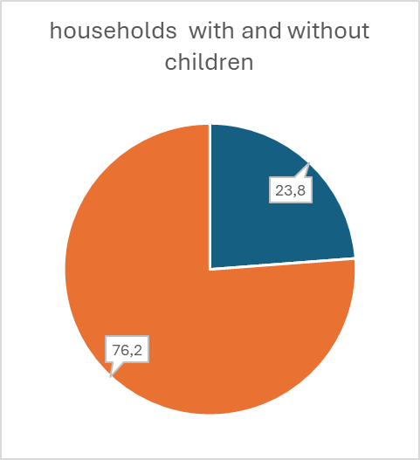
Talking about family (support)
eurofamnet.eu
Some numbers:
In 2023 approx. 200 million households
resided in the EU (27 countries)
23,8 % included children
76,2 % didn’t include children

Slide 4
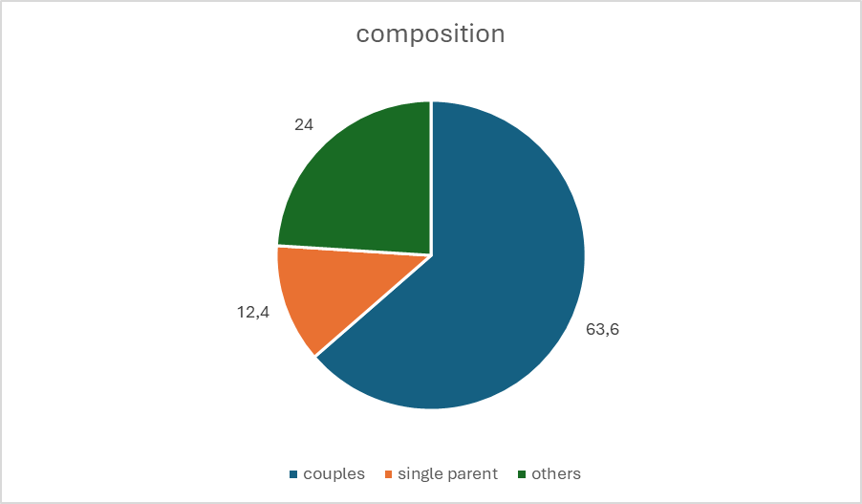
Talking about family (support)
eurofamnet.eu
Some numbers:
In 2023 approx. 200 million households resided in the EU (27 countries)
63,6 % are couples
12,4 % are single parent households
24 % are other types of households

Slide 5
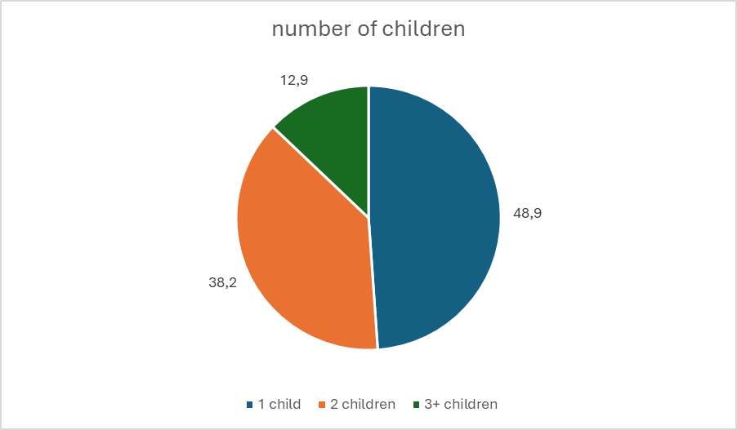
Talking about family (support)
eurofamnet.eu
Some numbers:
In 2023 approx. 200 million households resided in the EU (27 countries)
48,9% have 1 child
38,2% have 2 children
12,9% have three children or more

Slide 6
Talking about family (support)
eurofamnet.eu
Some more numbers:
All adults were employed in 60.7 % of households with economically dependent children in 2023 but only in 55.6 % of households without children.
All adults were working full-time in 38.4 % of households with children and in 41.9 % of households without children.
At least one adult was working part-time and all other adults (if any) were working full-time in 22.3 % of households with children, and in 13,7% of households without children
At least one adult was working and one adult was not working in 32,2% of EU households with children and only in 27.0 % of EU households without children.
No adults working: 7.1 % of households with children did not include any employed adults against 17.4 % of households without children

Slide 7
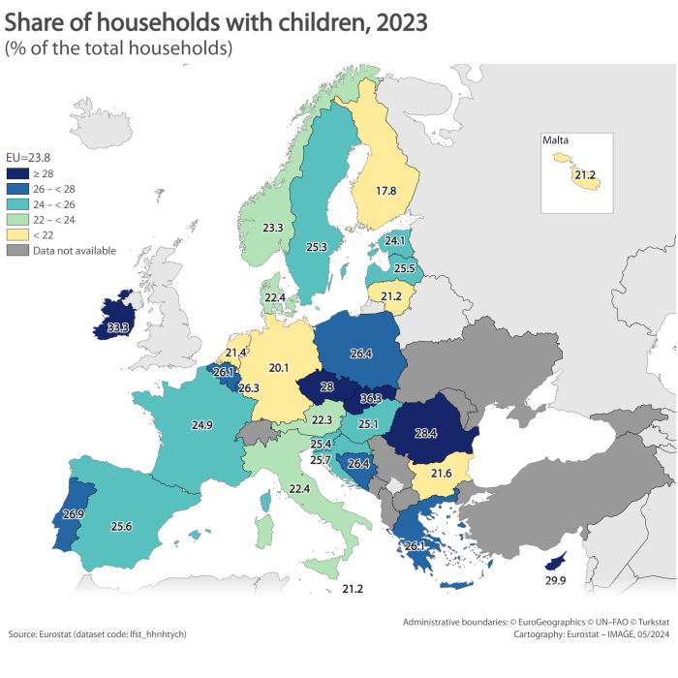
eurofamnet.eu
https://ec.europa.eu/eurostat/statistics-explained/index.php?title=Household_composition_statistics#Presence_and_number_of_children

Slide 8
Children at risk of poverty or social exclusion
eurofamnet.eu
Almost 20 million children in the EU were at risk of poverty or social exclusion in 2023. That number represents 24.8% of children under the age of 18.
At member states’ level, the highest shares were reported in Romania with 39.0%, Spain with 34.5% and Bulgaria with 33.9%.
In contrast, the lowest values were reported from Slovenia (10.7%), Finland (13.8%) and the Netherlands (14.3%).

Slide 9
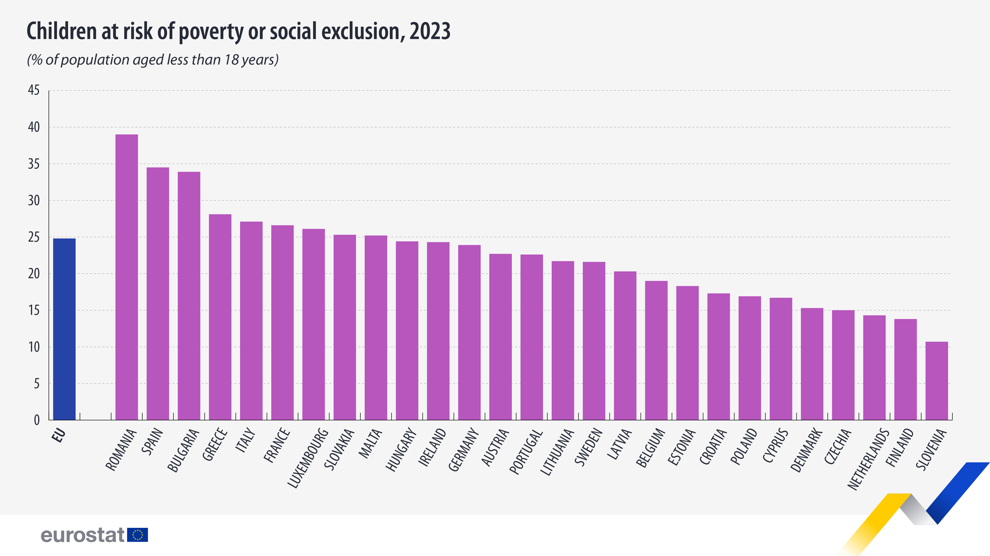
eurofamnet.eu

Slide 10
Becoming a parent
eurofamnet.eu

Slide 11
Being a parent
eurofamnet.eu

Slide 12
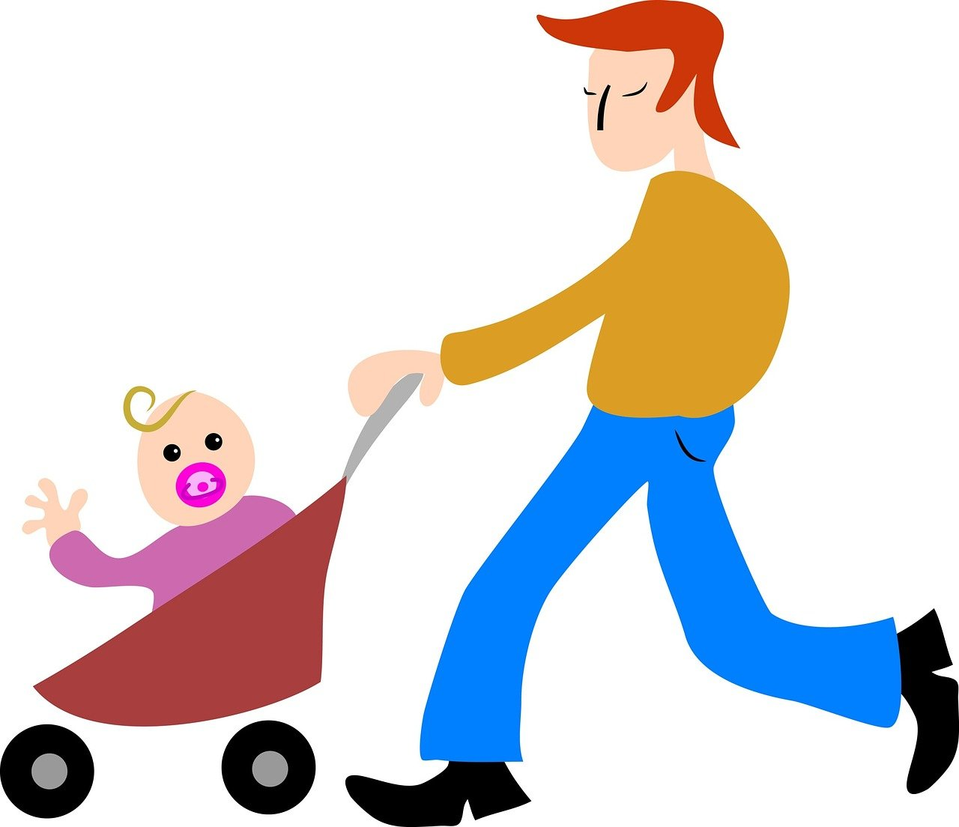
Being a stressed parent
eurofamnet.eu

Slide 13
Being an exhausted parent
eurofamnet.eu

Slide 14
Being an empowered parent
eurofamnet.eu

Slide 15
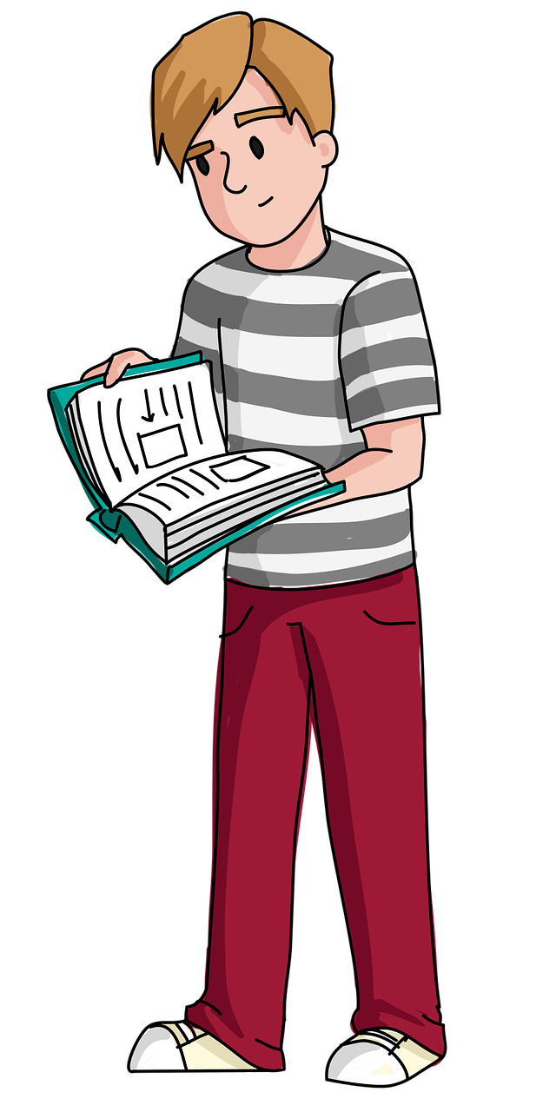
Successful parenting ;-)
eurofamnet.eu

Slide 16
Enjoying parenting
eurofamnet.eu

Slide 17
Conclusions
eurofamnet.eu
All families need support because
no one falls from heaven as a “born parent” – it’s learning journey for every parent
every child is a unique individual with specific characteristics and needs – so one-size-fits-all solutions usually don’t work
most families today are nuclear families and have to organize themselves as such often without help or support from other family members like grandmothers, grandfathers, aunts and uncles, cousins, etc.
raising children – even if it’s only one – is always a challenging and stressful endeavor
This is why family support systems are crucial to empower all parents to be the best possible parents for their children and to make sure that the children can develop in the best way possible guided and supported by their parents, guardians or other caregivers.

Slide 18
Quality Assurance in Child and
Family Support in Europe Policy lessons for evidence-informed decision making
Thank you for your attention!
Arja Krauchenberg
Project coordinator of the European Parents Association
EurofamNet Policy and Practice Group member

