Slide 1



THE EUROPEAN FAMILY SUPPORT NETWORK
Training School
FAMILY SUPPORT SKILLS:
Creating an agenda for family workforce skills research development
Belgrade May 9-11 2023.
CONCEPTUALIZATION
of family support workforce skills
Nevenka Žegarac, University of Belgrade
John Canavan, University of Galway

Slide 2
THEORY BUILDING IN FAMILY SUPPORT
Pinkerton et al., 2016

Slide 3
THEORY BUILDING IN FAMILY SUPPORT
Devaney et al., 2022

Slide 4

WHAT IS THEORY IN SOCIAL SCIENCE
Systematic collection of concepts and relations
Concepts
Relations between concepts
Propositions
Relations between propositions
Connections between propositions and the empirical world (observed data)
White, Martin and Adamsons, 2019, p.5

Slide 5
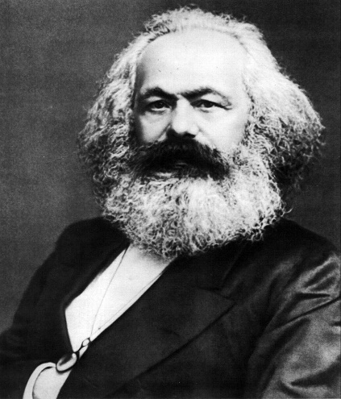
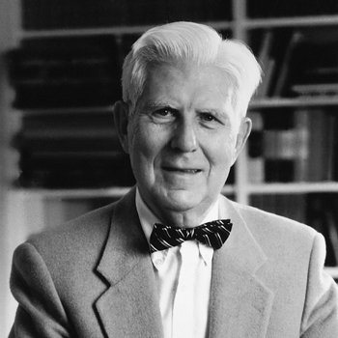

WHY DO WE NEED THEORY?
ACCUMULATION AND ORGANISATION
PRECISION – What do concept means; what do we include what do we omit
GUIDANCE – In our scientific work; theory development, testing, support and refute
CONNECTEDNESS – How ideas relate to each other
INTERPRETATION – Making sense of the phenomena of interest; good description, plausible picture
PREDICTION – Helping us see what might happen in the future
EXPLANATION – answering WHY and HOW questions
White, Martin and Adamsons, 2019, ps.12-13

Slide 6


How Can We Know the Social World? (1)
Ontology: what is the nature of the social world?(is it real?; is it is a construction of the mind?; is it both?; or is it impossible to know?)
Epistemology: theory of knowledge – how the world can be known (reason vs. empirical knowledge)

Slide 7
How Can We Know the Social World? (2)
 | Positivism / Post-Positivism | Interpretivism | Critical Theory
Ontological Assumptions | Observable World (possibly ‘real’) | World might be ‘real’ but what is available to us is what mind interprets | Real world exists but is distorted
Epistemological Assumptions | Independence of researcher and researched Possible to be free from / to limit biases | Not possible to separate researcher from researched/ interests and values present No ‘God’s eye view’ | Values enter but key issue is action towards emancipation

Slide 8
Theory for Family and Parenting Support Programmes

Slide 9
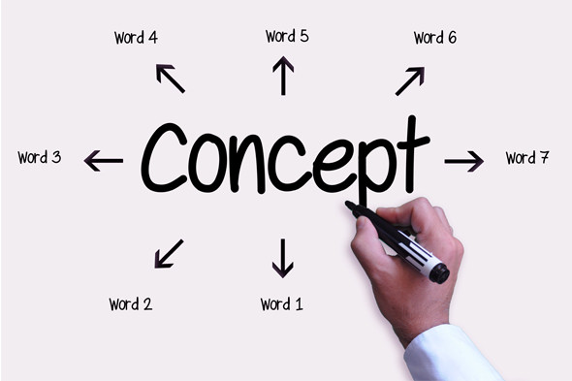
Concept(ualization)
CONCEPT(S) -the building blocks of thoughts. The notion or image that we conjure up when we think of some cluster of related observations or ideas – i.e. family, childhood, violence, famininity... NO universal definition
There is never a single, always-correct definition for concepts – crucial for empirical research, our terms mean only what we say they mean
Conceptualization – part of mesurement process - depends on how we plan to approach out research and writing out clear, concise definitions for our key concepts
Operacionalization - researcher precisely specifies how a concept will be measured

Slide 10

STEPS in conceptualization
Initial brainstorming + consult prior work to understand how others define the term in question
To consult previous research and theory to understand the other definitions - to change or to rely on previous definitions; helps in the process of refining research question.
Clear definition: every term used will make sense to others, including terms used within definition
Qualitative research: working definition - understandings and experiences of participants, definition change over the course of the research
Quantitative research: definitions must be completely set in stone before the inquiry can begin

Slide 11

Multiple dimensions of concepts
When there are multiple elements that make up a single concept
Conceptualization must be open to revisions, even radical revisions, as scientific knowledge progresses - Not falling in love with your definition!
Reification– assuming that abstract concepts exist in some concrete, tangible way

Slide 12
Family support workforce skils
To start from a focal phenomenon that is observable but not adequately addressed in the existing research:
  Skill(s)?
  Family support?
  Family support workforce?
  Family support workforce skills?
In selecting particular concepts and theories, the researcher is de facto making an argument (claims, grounds, and warrants ) about the conceptual ingredients of the empirical phenomenon in question.
Conceptual clarity
Parsimony
Simplicity
Logical coherence
Notes:
Family support workforce skills sounds familiar, yet confusing. On many levels, the concepts we deal with, which are key to parenting and family issues, are not clear or unequivocally accepted.
First, there is no agreement on what skills are, despite years of research from numerous scientific disciplines.
Then, family support is a well-known and moslty accepted term, with different meanings. Family support workforce and their skills are new terms, although it is widely recognized that various disciplines work in the field, and that in their work they primarily rely on their support and helping skills

Slide 13
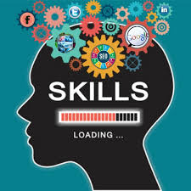
Conceptualizing family support workforce skils
The structure should reflect both the aims of the research and the role of the various lenses deployed to achieve those, the structure highlights what the authors seek to explain.
A clear structure also contributes to conceptual clarity by making the hierarchy of concepts and their elements intuitively available to the reader, eliminating any noise that might distort the underlying messageand avoiding redundancies (Hirschheim , 2008)
Credibility: to carefully document all analytic decisions that lead to the creation of categories: to systematically maintain the connections between the codes and categories and the empirical evidence found in the data themselves
Verfication from external or third parties

Slide 14

Conceptual framework
Family support workforce
Relevant social sistem
Professional framework & occupations
Social work
Psychology
Pedagogy
Medicine
Support to families as a whole and their members
Developmental, compensatory or protective support in order to provide subsistence, productive development and integration of family into community;
Advocate services from human and child rights framework
Professional skills’ of the
FS workforce
Law
*Paraprofessionals
Collaborative ways to supporting different aspects of family functioning in a competent manner;
Performance in serving families using holistic, strengths and relationship-based practice approach
Sector and Level
Social welfare
Health
Mental health
Education
Justice
Government / non-government organisations;
International / regional level
Family Support Workforce

Slide 15
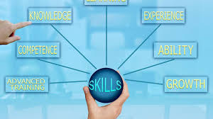
Conceptual framework
Family support workforce skills
Learned ability of doing things in collaborative ways, while supporting different aspects of family functioning, and the ability to use their knowledge effectively and readily in execution or performance in serving families using holistic, strengths and relationship-based practice approach.

Slide 16

Conceptualisation of FS workforce skills
  Process of mapping documents of international, European and other organizations dealing with families
  Systematic review(s) of the literature (peer rewiew journals & books)
  Complex guided discussion on clarification of the common understanding of key concepts
  Delphi study
Family/children support international organizations/agencies (46 organizations)
Family therapy, occupational therapy, family educators and family support paraprofessionals (12 organizations)
Youth support work (30 organizations).
1st round
31 experts, 23 countries
8 open-ended questions + demografic data
2nd round
27 experts
Ranking questions Definition, list of skills, approaches, typology
3rd round
27 experts
Yes/ No questions
Notes:
During the conceptualization of these skills,
we mapped documents of international, European and other organizations dealing with families and made three connected maps;
We did two systematic literature reviews (peer review journals & books) with numerous discussions for clarification of the common understanding of key concepts;
and we organized a Delphi study in three rounds, which included 31 experts from 23 European countries

Slide 17

Consensus in Delphi study
51% responding to the category “totally important/crucial” (Hackett et al., 2006)
Interquartile range below 1 (Rayens & Hahn, 2000)
Standard deviation below 1.5 (Christie & Barela, 2005)
Reached on all examined items
  in the range of 74.1% (for the definition of family support workforce skills)
  to100% (for agreement regarding the necessary knowledge)
  both core and field-specific skills reached an agreement between 74.1% and 96.3%.
  the combination of family support workforce qualities across different professions obtained a consensus between 88.9% and 96.3%.

Slide 18
Set of core skills for family support workers across different professions and settings
APROACHES
Strength
Relationship -based
Whole family
Child - centered
FIELD SPECIFIC SKILLS
Partnership & collaboration
Advocacy & empowerment
Set of core skills
Set of empathic skills
Listening skills
TRAITS
Integrity
Commintnment
Flexibility
Building trust & confidence
Problem solving
User friendly communication
AMALGAM
Non-judgementalness
Ethical stance and conduct
Manage emotionally demanding situations
KNOWLEDGE
Family life cycle, dynamics & stresses
Child development
Social context, poverty, and discrimination;
Services &systems of support
Notes:
This

Slide 19

Characteristics of a Good Concept and Construct (Gerring, 1999)
Each concept should be familiar to the intended audience, and its chosen term or name should resonate with people - “cognitive click”
The name of the concept should be simple (parsimonious) as should the list of defining attributes (i.e., what it intends to capture or reflect about reality)
The concept should exhibit internal consistency, meaning its attributes and the attendant aspect of reality are logically related
The concept should also be discernibly different
from other existing concepts (differentiated)

Slide 20

Comments?
Thoughts?
Ideas?
...

Slide 21
Sources
Buciuceanu-Vrabie, M., Mešl, N., Zegarac, N. and Kodele, T. (2023). Skills in family support: content analysis of international organizations’ websites. Quality of Life https://revistacalitateavietii.ro/journal.
Christie, C. A. & Barela, E. (2005). The Delphi technique as a method for increasing inclusion in the evaluation process. The Canadian Journal of Program Evaluation, 20(1), 105-122.
Devaney, C., Churchill, H., Abela, A., & Jackson, R. (2022). A framework for child and family support in Europe. Building comprehensive support systems. [Policy brief]. EurofamNet.
Gerring, J. (1999). What Makes a Concept Good. a Criteria Framework for Understanding Concept Formation in the Social Sciences. Polity, Vol. 31, No. 3 (Spring, 1999), pp. 357-393
Gilson, L. & Goldberg, C.B. (2015). Editors' Comment: So, What Is a Conceptual Paper? Group & Organisational Management 40(2):127-130
Jaakola, E. (2020). Designing conceptual articles: four approaches. AMS Review 10:18–26 https://doi.org/10.1007/s13162-020-00161-0Iqbal, S., & Pipon-Young, L. (2009). The Delphi method. The Psychologist, 22, 598–600. https://www.bps.org.uk/psychologist/delphi-method
Hackett,S., Masson, H. Philips, S. (2006). Exploring Consensus in Practice with Youth Who Are Sexually Abusive: Findings from a Delphi Study of Practitioner Views in the United Kingdom and the Republic of Ireland. Child Maltreatment 11(2)
Pinkerton, J., Canavan, J. & Dolan, P. (2016) Understanding Family Support, London: Jessica Kingsley.

Slide 22
Sources
Rayens, M. K. & Hahn, E. J. (20000). Building Consensus Using the Policy Delphi Method. Policy, Politic & Nursing Practice 1 (4)
White, J.A., Martin, T.F, & Adamsons, K (2019) Family Theories An Introduction (5th Ed.),Thousand Oaks, CA: SAGE
Zegarac, N., Burgund Isakov, A., Nunes, C., & Antunes, A. P. (2021). Workforce skills in family support: A Systematic review. Research on Social Work Practice, 31(4), 400-409. https://doi.org/10.1177/10497315211006184.

