Slide 1



THE EUROPEAN FAMILY SUPPORT NETWORK
Training School
FAMILY SUPPORT SKILLS:
Creating an agenda for family workforce skills research development

Slide 2

Qualitative and creative methods in skills Qualitative and creative methods in skills research
https://eurofamnet.eu
Prof. Nevenka Žegarac, University of Belgrade, Faculty of Political Sciences
Assoc. prof. Nina Mešl, University of Ljubljana, Faculty of Social Work

Slide 3
Qualitative research process
Communication practice that produces knowledge: sense/meaning that certain phenomena have for children/ families/ professionals and research into the quality and content of their experience
Question
Literature research / theoretical basis
Organization and realization
observation/ interview/ FG
Transcript
Analysis
Creating a resarch guide and tools

Slide 4
Theoretical framework of qualitative research – interpretive
Relying on narrative forms of explanation: a story/ narative that helps to explain how certain behaviors, practices, institutions become what they are and how they are maintained
Constructivism - the construction of knowledge and reality through the interaction of cultural, historical, social and individual factors
Critical theory - researchers strive not only to learn about the world, but also to change it; power and action
Grounded theory - concepts are based or "grounded" in data obtained from participants who experienced the researched phenomenon/process - an explanation of a process and interaction
Feminist theories - understanding the nature of inequality, focus on power relations and gender issues; equalizing power and/or reducing the power imbalance
  DATA COLLECTION METHODS: Observation, interview, focus groups, case studies, content analysis, ethnographic method...) to determine the meaning and understanding of certain occurrences/phenomena/processes
  QUALITATIVE DATA ANALYSIS: Content analysis; Thematic analysis: Narrative analysis: Grounded theory analysis; Discourse analysis

Slide 5
To hear the voices of all involved
Values and principles (contribution, respect, trust, communication)?
Meaningful participation and co-creation – to be heard
Partnership or Engagement: research ON or WITH / BY?
Potential vulnerability?
Positive and encouraging experience
Informed consent/ Power balance
The environment: home, playground, school, office, community
Adjusment of communication
Unique insights and the practice of active creation of meaning
Relevance and legitimacy of research for invoved parties
Influence on research dessign, proces and interpretation
Prophylactic against scientific harm and better public unederstanding
Positive outcomes/ impact
PARENTS /OTHER FAMILY MEMBERS
CHILDREN
PROFESSIONALS
POLICY MAKERS
MANAGERS
Neglecting the experience of children;
Minoritized, marginalized and oppressed
Child: natural, predictable, unimportant
Work overload
The role of the professionals in the research
How to research work processes

Slide 6

NEUTRALITY - OBJECTIVITY - GENERALIZABILITY - COMPLIANCE - VALIDITY
  What does each of these characteristics mean in the qualitative research process?
  How is it achieved?
  How can it be compromised?
Discussion: specifics in research with
children and families
APPROACHES: Research subject; Consultiatve; Collaborative; Child/ Parents/ Family lead;
ROLES: Advisors; Interviewees; Co-researchers; Development workers

Slide 7

Etical principles
Respect and relevance
Non- maleficence (“do no harm”) and beneficence (“do good”)
Justice/ non discrimination / inclusivness
Adapted/ tailored to a specific population, child / parents and family friendly
Best interests of the child
Voluntariness/ transparence/
Confidentiality (including privacy and anonymity)
Safety and risk sensitivity
The right to be heard and properly researched
  Critical reflection, cross-cultural, intersectoral and interdisciplinary dialogue
  Context-specific problem solving

Slide 8
Discusion:
“hard to reach / research” children and parents/ families
Children | Parents/ families

Slide 9
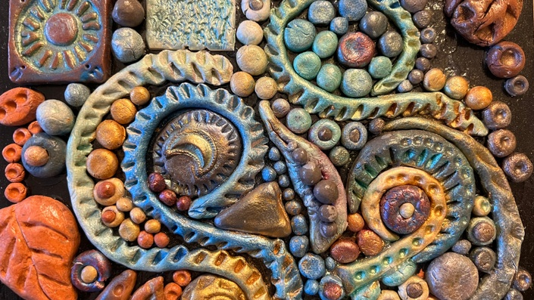
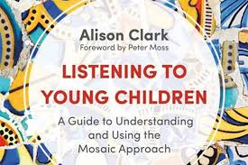
Mosaic approach
Socio-constructivist paradigm - adults and
children are seen as co-constructors of meaning
Reflexivity: adults need to be aware of the way they
interpret children's experiences
Multiple methods to highlight children's
perspectives and experiences - a framework for
incorporating different methods through which
children and those who care for children can create
a picture or 'mosaic' of children's lives. The artifacts
produced are a stimulus for further exploration of
meaning, together with long children, researchers
and other adults - both results and implications are
considered

Slide 10

Visual techniques
Maps, drawings, photos, model building, ranking and grading, guided tours
To show adults the environment in which the child resides, and the issues that are important to him/ her
To indicate the child's attitude towards the environment
For the child to give his assessment of the environment and
ideas for its improvement

Slide 11
BODY MAPPING
I like it / I don't like it
To explore what children like and dislike about the work they do and how the work affects different aspects of their lives
ONE OF MY DAYS
A timeline to explore children's roles and responsibilities in everyday life and to reflect on the ways in which children balance housework, paid work, study, play and other opportunities

Slide 12
GUIDED TOURS - CHILDREN LEAD
Objective: To investigate what children like/dislike about the work they do

Slide 13
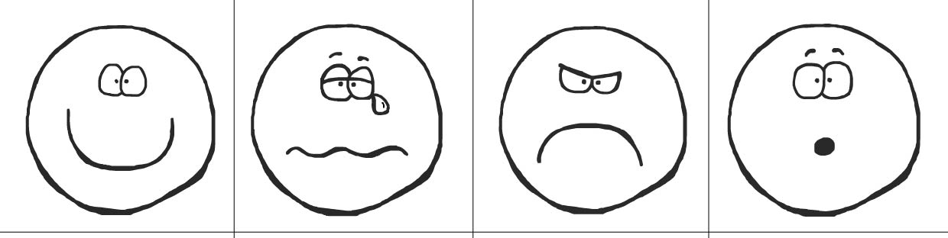


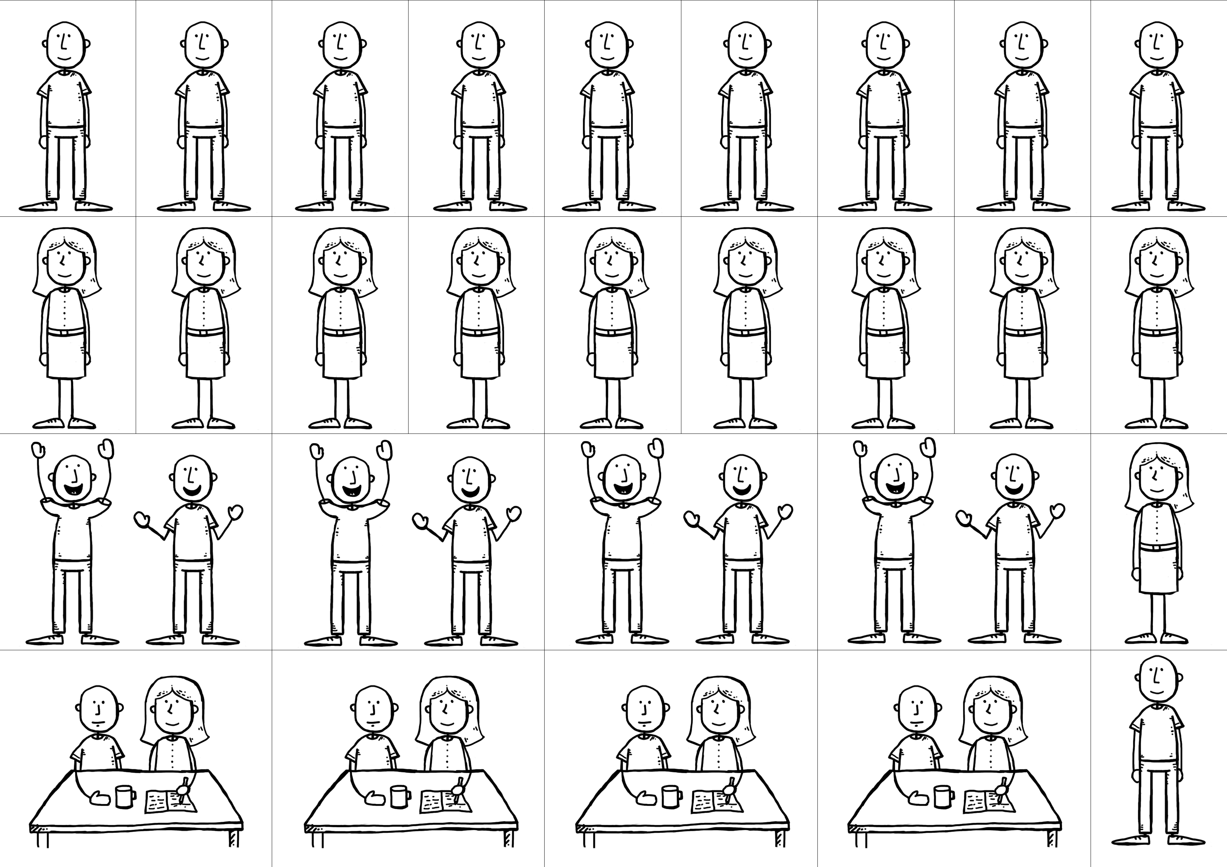

Slide 14
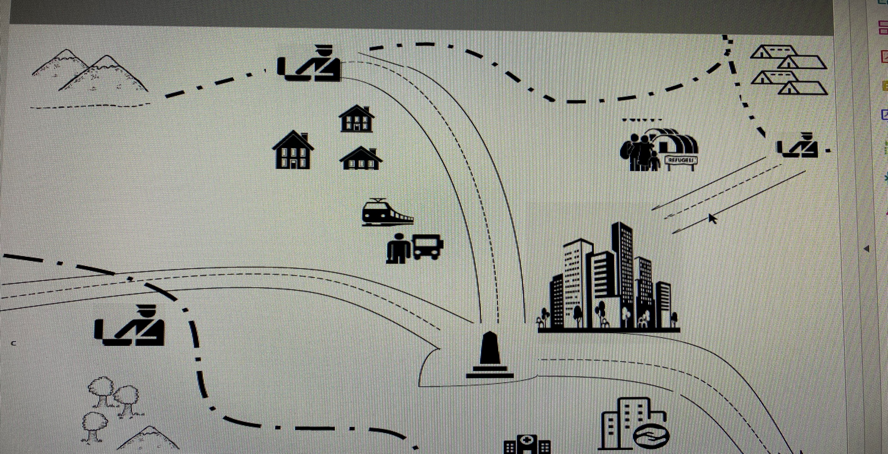
Road map, Žegarac, Burgund Isakov, Marković, 2019

Slide 15
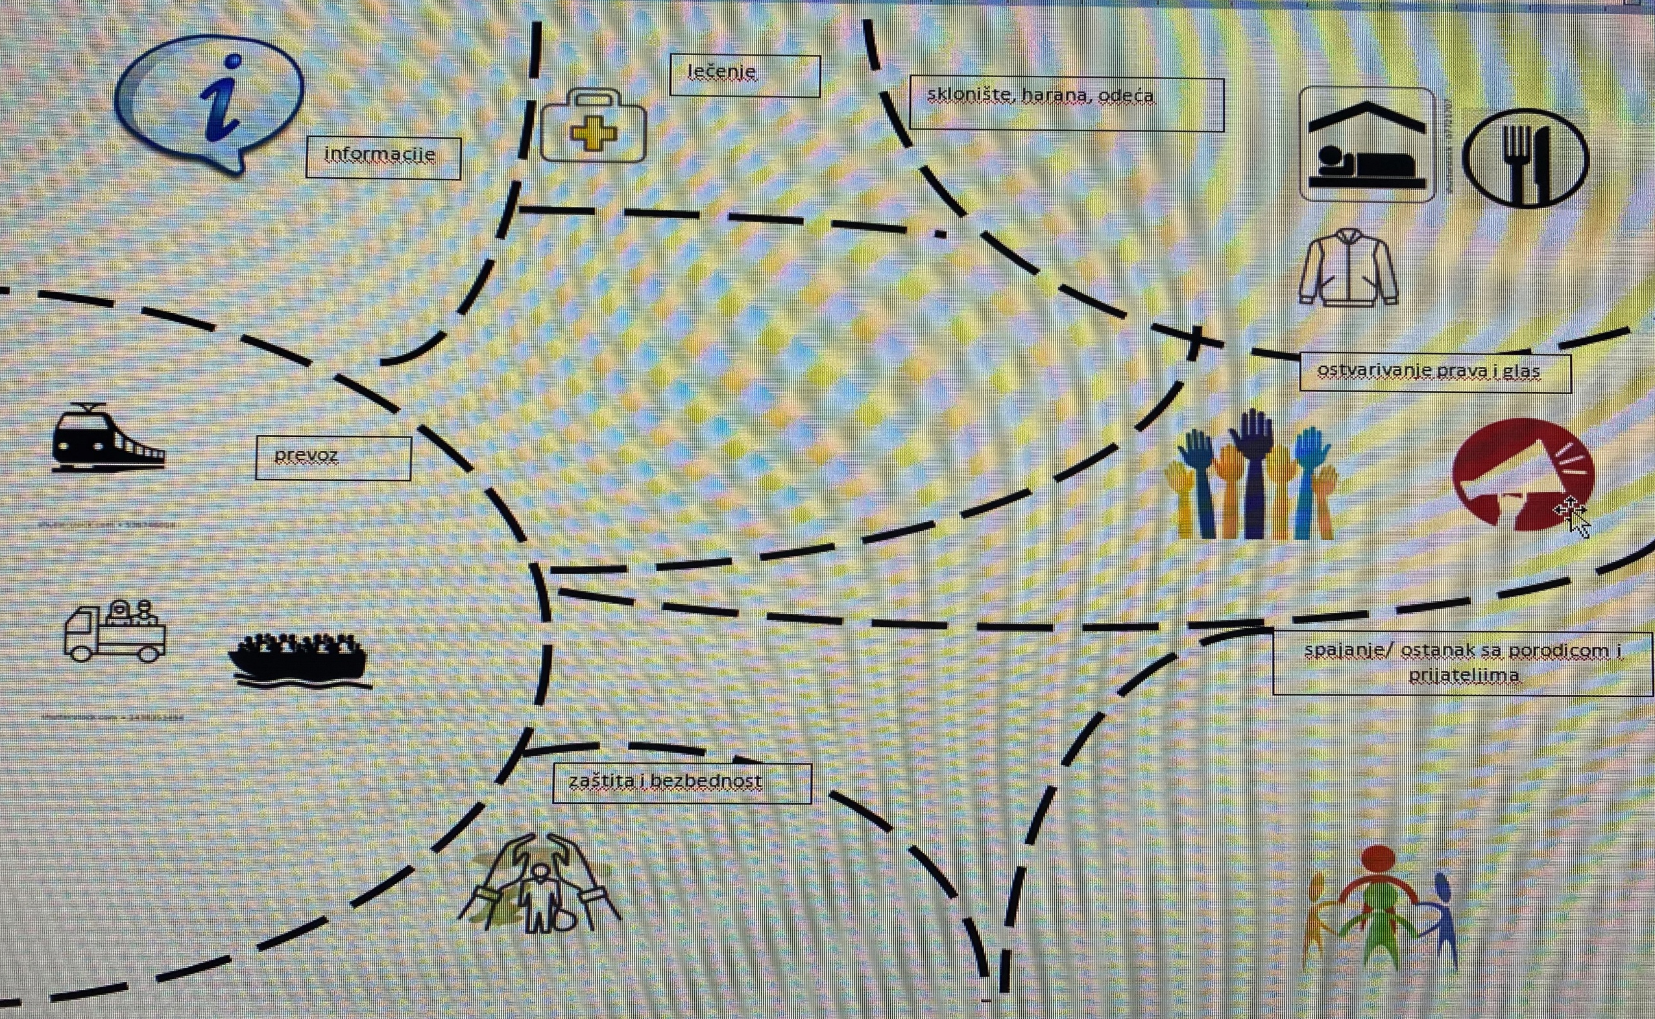
Support map , Žegarac, Burgund Isakov, Marković, 2019

Slide 16
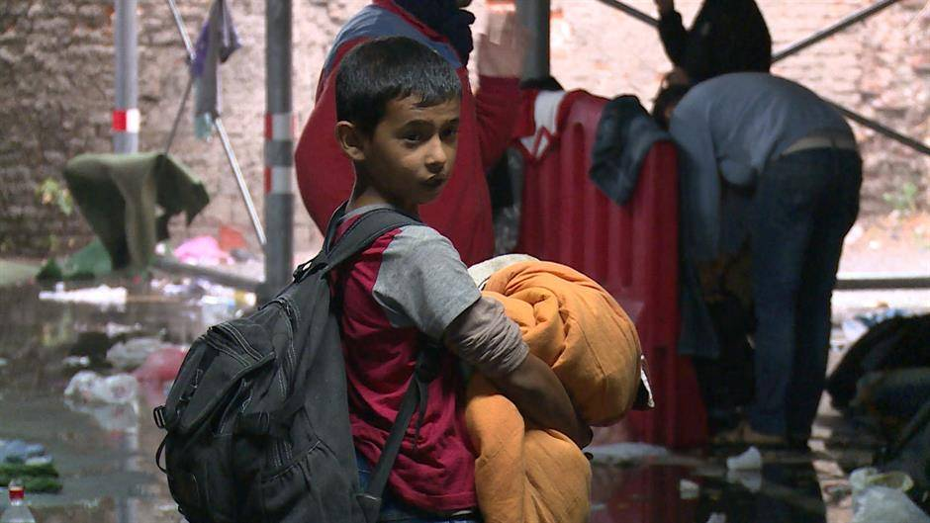
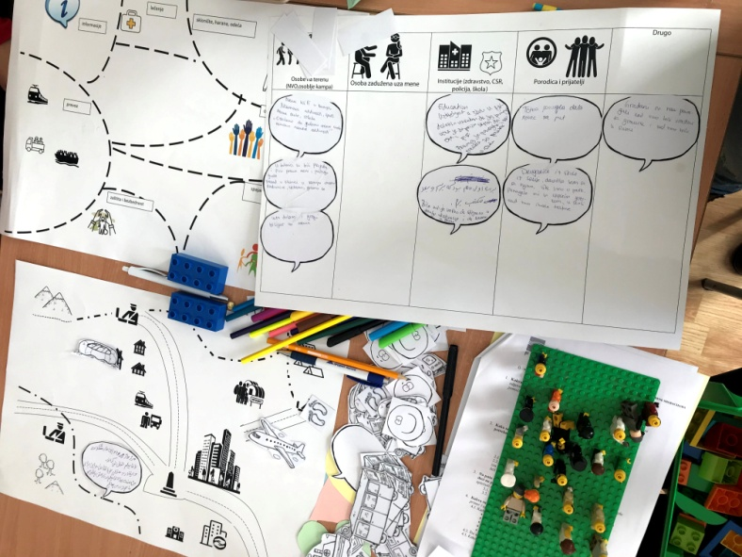

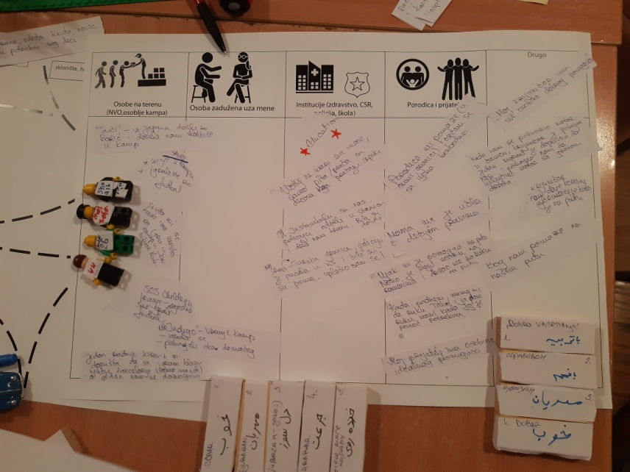
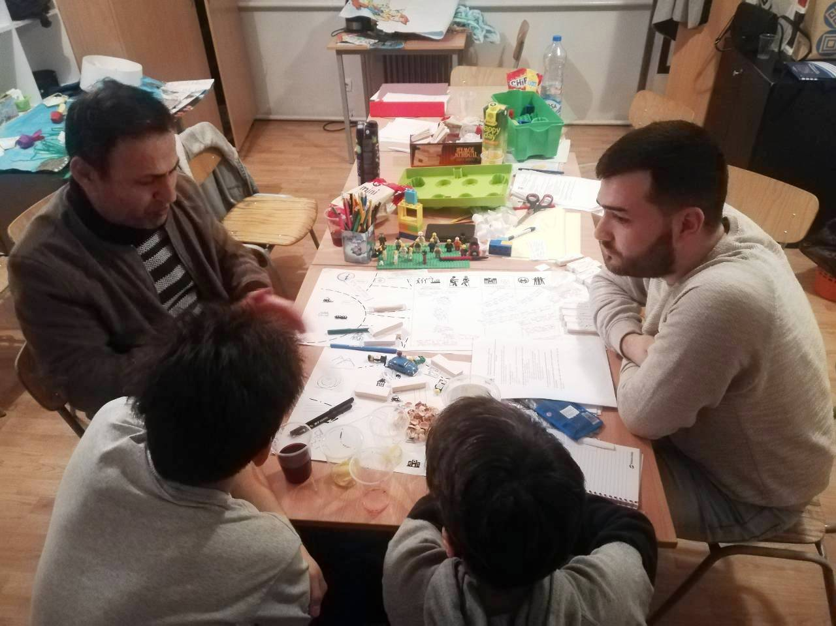
Faculty of political sciences, Belgrade
March 2020.

Slide 17
Avramovic & Zegarac (2016) Me at the Center: Perspectives of children with disabilities on community-based services in Serbia. Children’s Geographies

Slide 18
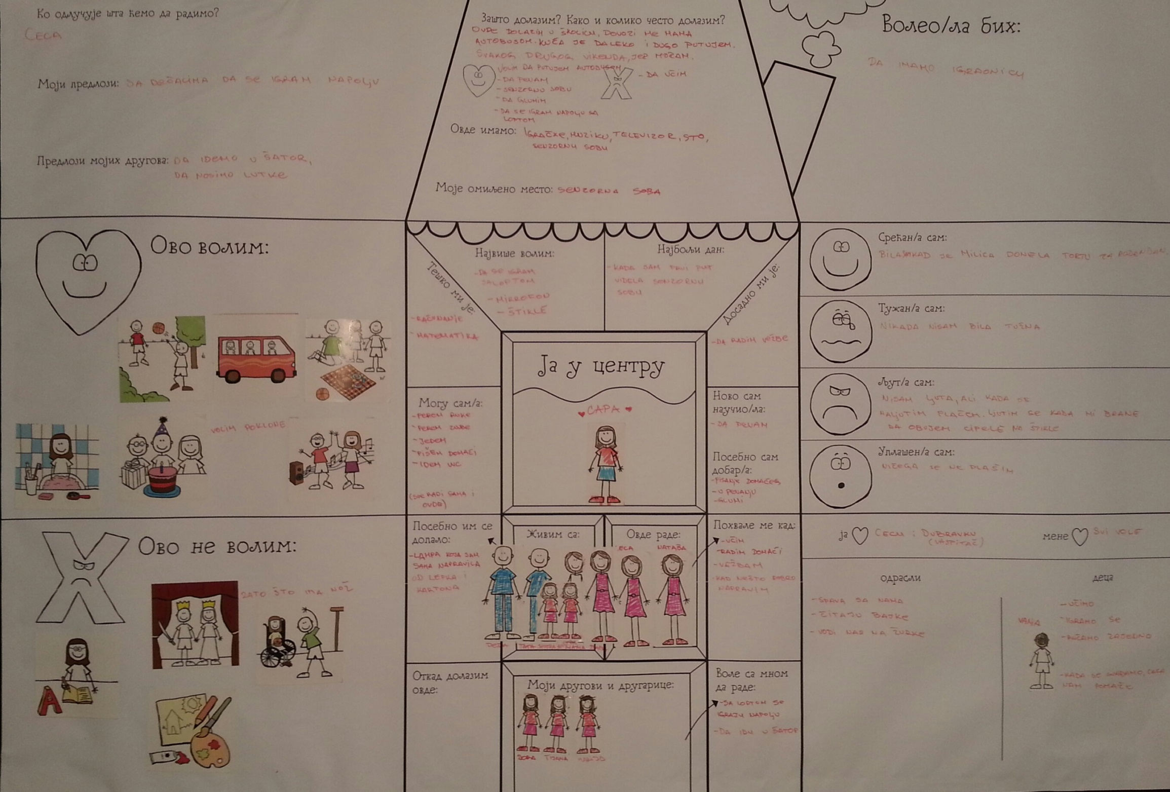
Girl 10 y, medium learning disability
Avramovic & Zegarac (2016) Me at the Center: Perspectives of children with disabilities on community-based services in Serbia. Children’s Geographies

Slide 19
Decision making in the shelter - girls included
into sexual exploitation (De Sas Kropiwnicki, 2006)
 | Eating | Sleeping | Friends | Boyfriend | Money | Jobs | Touch
Me |  | ∇ | • | • | • | ∇ | •
Educator | • | • |  |  | • |  | •
Manager of the shelter | ∇ | • | ∇ | • | • | ∇ | •
Friends |  | ∇ |  |  |  | ∇
Family | ∇ | ∇ | ∇ | ∇ | ∇ | ∇ | ∇
A little ∇ Somewhat • A lot

Slide 20
Decision making on the street - girls included
into sexual exploitation (De Sass Kropiwnicki, 2006)
 | Eating | Sleeping | Friends | Boyfriend | Money | Jobs | Touch
Me | ∇ | • | • | • | • |  | •
Friends
Police | ∇ | • | • |  |  | • | ∇
Madam |  |  | • | • | • | • | ∇
Family | ∇ | ∇ | ∇ | ∇ |  | ∇ | ∇
Man | ∇ | • |  |  | ∇ | ∇
Teacher | • | ∇ | •
Older children |  |  | ∇ | ∇ |  |  | ∇
A little ∇ Somewhat • A lot

Slide 21

Concensus bulding activities in 30 Focus groups
ADOLESCENTS |  | CASE MANAGERS AND COUNSELORS |  | FOSTER PARENTS
1. Conectedness | 14 | 1. Identity | 7 | 1. Conectedness | 5
2. Personal relationships | 6 | 2. Conectedness | 6 | 2. Identity | 3
3. Adequate standard of living | 5 | 3. Adequate standard of living | 4 | 3. Personal relationships Adequate standard of living Self-satisfaction Education | 1
Žegarac & Krnjajić (2019). Wellbeing of adolescent on foster care. Begrade: UB FPS

Slide 22
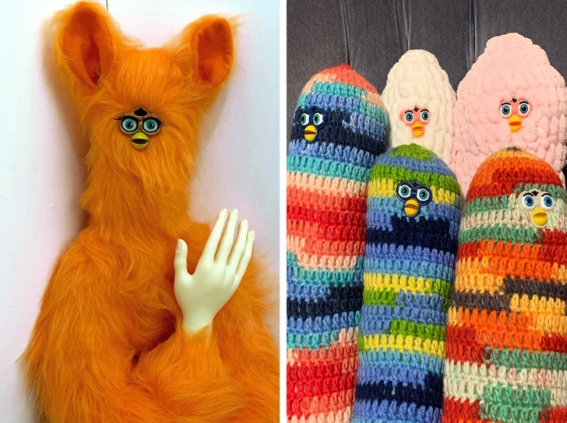

Expressive techniques
drawing, sculpting, expressing through movement, role-playing, etc., allow children to express their feelings and perspectives visually or kinesthetically, which may be a more accessible way of expression than verbal

Slide 23
Draw and write a poem or story...

Slide 24

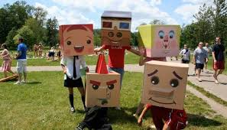
Creative techniques and other stimulating materials
Creative techniques: journalistic reporting, use of puppets, making videos, films, creating and telling stories, theatrical performances, dramatizing problems or situations
Theater for Development (TfD) conceptualizing, writing, performing: artistic objects, music, dance, song to analyze the problem and find its roots

Slide 25
The Tree of Vision
Goal: both visual and creative children's / parents/ family view of:
Their future vision and hopes - whether their current life and opportunities help/hinder them in achieving their future goals and dreams
Existing strengths and services that can be enhanced and improve the lives of children and families
Advocacy and action initiatives to improve children's working lives and to ensure that families are supported

Slide 26

H assessment of existing policies, laws and research approaches to children's views on family support
 | No of participants, age, sex, status

Slide 27

Guidelines for the use of creative / visual techniques
Train researchers in the use of particpative/ creative/ visual techniques
Inform children about the use of techniques
Provide space and appropriate techniques for children to express themselves
Balance fun with data collection
Respect children's choice to (not) use visual and creative techniques
Check the way children understand the use of visual and creative techniques
Document both the process and the experiences
of the researcher

Slide 28
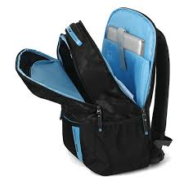

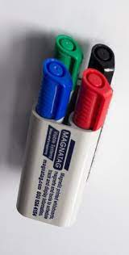
Researcher's Bag
Protocol
Sufficient number of consent forms
Sufficient amount of INFO about research
Dictaphone
Sticky papers & markers
Flip chard paper
Colored paper
Pencils
Scissors
Adhesive tape

Slide 29
The voice of the professionals
There is less concern about experts not being involved in research.
The question is what kind of research material we collect.

Slide 30

PROFESSIONALS
How to get closer to what practitioners
actually do in practice?
The methodological challenge is to explore work processes, theories in use, skills.
There may be a difference between what professionals say they do and what they do.

Slide 31

PROFESSIONALS
Competent professionals usually know more about carrying out quality practice than they can articulate (Schön, 1987, 1991).
But we need a step further to be able to collaborate with families:
- knowledge and words to name our work in order to be able to co-create desired outcomes together.

Slide 32

(Why) do we need research on work processes, theory in use, skills?
knowledge development, financing, reflection of practice, working in multidisciplinary teams etc.
! and to research ways that will allow moving closer to explicit definitions of our actions is a way moving towards collaboration with families

Slide 33
THE USE OF THEORIES IN PRACTICE (Schön, 1987)
THEORIES OF PRACTICE
THEORIES OF ACTION
ESPOUSED THEORIES THEORIES-IN-USE
explicit knowledge implicit knowledge
behavioural world

Slide 34

Research into the Use of Implicit Theories of Action in Social Work Practice
/The Case of Social Work with Families in Slovenia/ (Nina Mešl, 2004-2007)

Slide 35

Research
Qualitative and quantitative methods of data collecting and analyses
Three phases of research:
the interview in the field of their work, their theoretical starting points, etc. + collection of written documentation for the analysis
in-depth interview on the working process in the chosen case, the filling in of the evaluation scale for all cases chosen
the group interview (reflection on the research results )

Slide 36

In-depth interviews with each social worker on the working process
Three main questions framed the interview in the 2nd phase:
What happened in the case? What did you do? and Why did you do that?
The number of used codes in causal analyses of all interviews
code | event | action | purpose of action
number | 70 | 105 | 30

Slide 37
COMPARISON OF THE MEANS OF THE INDEXES OF INDIVIDUAL WORKING CONCEPTS

Slide 38

DISCUSSION
Various reasons for the differences in the mean estimates of the use of the different working approaches:
the research method (researcher’s evaluations were based on the analysis of written documentation)
the gap between the espoused theories and the theories-in-use which define the social workers’ behavioural world in practice.
Both interpretations were confirmed by the social workers in the third research phase.

Slide 39


When we collect a lot of material in qualitative research
let's start with the analysis…

Slide 40





Qualitative analysis manually using a computer programme for qualitative analysis

Slide 41
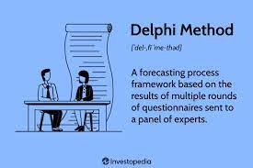
The Delphi study on family support skills (FSS)
1st round: open-ended questions
from the analysis of the qualitative material to the design of the questionnaire for quantitative research (2nd and 3rd round)

Slide 42

Analysis 1st round: open-ended questions
31 experts, 23 countries, different areas of family support
a qualitative analysis of the collected material
two researchers conducted the coding separately
the first round of analysis included all the statements identified by the participants in each questions as a predefined theme
MAXQDA qualitative data analysis software (categorisation of text into thematic codes, overall representation of various codes, and analysis of the coded text) + coding by themes and categories in text (using Word).

Slide 45
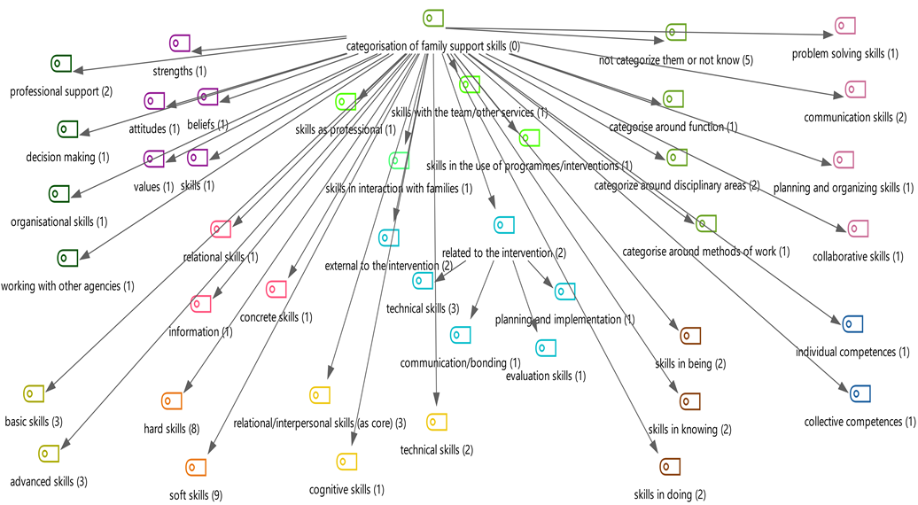
Proposed categorisations of FSS

Slide 46

Comments?
Thoughts?
Ideas?
...

Slide 47
Literature
Clark, A. (2017) Listening to young children: a guide to understanding and using the Mosaic approach. Third edition. London: Jessica Kingsley Publishing.
Creswell, W. J. And Creswell J.D. (2017). Research Design: Qualitative, Quantitative, and Mixed Methods Approaches. 5th edition SAGE Publications.
Creswell, W. J. (2007). Qualitative Inquiry & Research Design – Choosing Among Five Approaches
Ferguson, H. (2014). Researching social work practice close up: Using ethnographic and mobile methods to understand encounters between social workers, children and families. The British Journal of Social Work, 46(1), 153-168aches. London: SAGE Publications
Holland, S., Renold, E., Ross, N. J., & Hillman, A. (2010). Power, agency and participatory agendas: A critical exploration of young people’s engagement in participative qualitative research. Childhood, 17(3), 360-375.
Schön , D. (1991). The reflective practitioner: How professionals think in action. Aldershot etc.: Ashgate-Arena.
Shaw, I., Ramatowski A., Ruckdeschel, R., (2013) Patterns, designs and developments in qualitative research in social work: A research note, Qualitative Social Work 12(6) 732–749
Ritchie, J. And Lewis, J. (Ed) (2013) Qualitative research practice - A Guide for Social Science Students and Researchers. London: SAGE Publications.

