Slide 1



THE EUROPEAN FAMILY SUPPORT NETWORK
Training School
FAMILY SUPPORT SKILLS:
Creating an agenda for family workforce skills research development

Slide 2

Reflection on the role of public services: assessing the support mechanisms provided by family and parenting services
https://eurofamnet.eu
Elona Bokshi
Policy Manager, European Social Network (ESN)
Notes:
European Social Network (ESN) carried out a survey amongst its members working in
children services in August 2012 to assess the support mechanisms provided by family and
parenting services across Europe, particularly to evaluate the extent to which this support
can help reducing child poverty. ESN wanted to focus on this, because it is an aspect of
social services that has been underplayed so far in EU policy discussions. In the survey,
ESN tried to assess a number of areas; from factors leading to disadvantage through forms
of family support to outcomes measurement.

Slide 3




170+
About us
Member Organisations
A growing community of public authorities at local, regional and national level and organisations responsible for social services representing more than one million professionals across Europe and beyond.
34
Countries

Slide 4
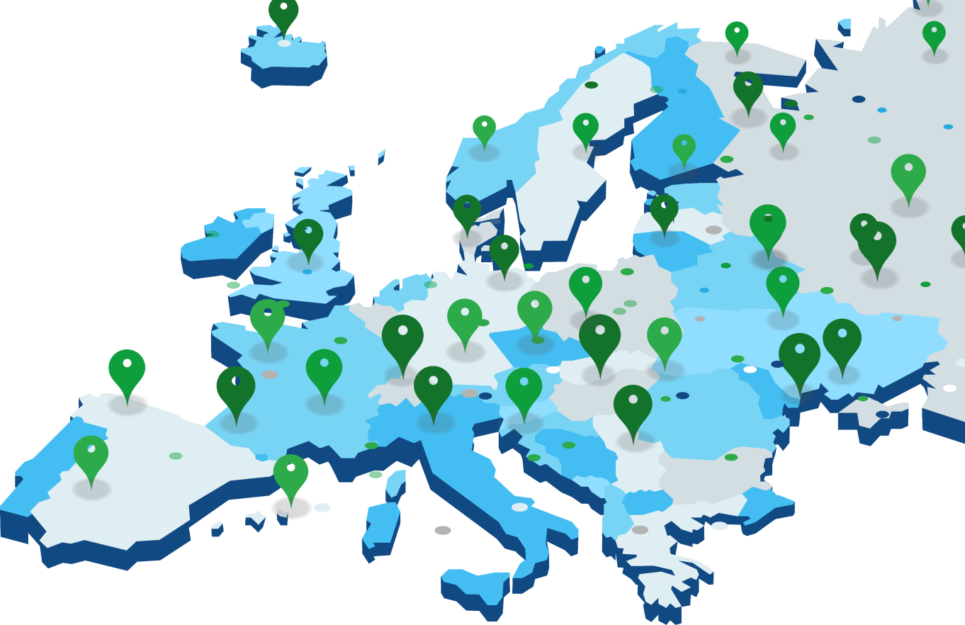
OUR MEMBERS
Organisations part of ESN:
Social Services Departments in Public Authorities
Association of social services Directors
Providers, NGOs
Inspection agencies
Associations of Social Workers
Universities, research institutes

Slide 5



WHAT WE DO
Provide an international exchange and sharing platform for local and regional social services
Strive for a Europe where local and regional social services are genuine partners of the EU
Empower professionals and people using social
services by promoting quality in service management

Slide 6
HOW WE DO IT
Exchange of knowledge and experiences
Promote innovative models in public social services
Promote efficient and effective social services and social inclusion policies
Facilitate exchange & implementation of best practice
Bring policymakers, researchers & practitioners together
Support social policy development
Strengthening members’ capacity, communications,
and impact

Slide 7


PART 1
Overview: understanding the role of social services in the family support setting?
PART 2
Provision of the family and parenting support
Structure
PART 3
Support mechanism provided by social services
PART 4
Final reflections on the family support skills
PART 5
Practices from ESN

Slide 8
Part 1-Supporting families in a complex situations is one of the core duties of the public services and regional and local level.
https://eurofamnet.eu
Disadvantaged children, families, and young people in a range of forms including
    support for parents,
    child protection,
    alternative care arrangements,
    and supporting vulnerable young people in education, employment or housing as well as in their transition from the care system into adulthoods
Notes:
Target group:
According to ESN, the definition of poverty should account for the economic and social
obstacles that the most disadvantaged children face such as lack of financial means, social
exclusion, disability, mental health problems, alternative care, risk of neglect/abuse,
undocumented child migrants/asylum-seekers, Roma and traveller children.
European Social Network (ESN) carried out a survey amongst its members working in
children services in August 2012 to assess the support mechanisms provided by family and
parenting services across Europe, particularly to evaluate the extent to which this support
can help reducing child poverty. ESN wanted to focus on this, because it is an aspect of
social services that has been underplayed so far in EU policy discussions. In the survey,
ESN tried to assess a number of areas; from factors leading to disadvantage through forms
of family support to outcomes measurement.

Slide 9
Part 1- What are the groups of children in a situation of vulnerability/disadvantage?
https://eurofamnet.eu
Children who are victims of violence or sexual abuse
Children with mental health problems, physical disabilities or sensory impairments
Young offenders
Children from minority ethnic groups or from migrant families
Children who have drug addiction problems
Children in institutions and out-of-home care
Children who live in large and single parent families living at or below the poverty line because of not earning enough in their paid employment.
Notes:
First it is important to clarify what is the target group we are covering here
In 2008 ESN decided to approach the important social challenges affecting children and
families through a working group that brought together people with experience of
managing mainstream public childcare and specialized services for vulnerable children
alongside others with a strong background in research and policy development. Based
on the work of the Group, ESN has identified the following groups of children in
situations of vulnerability:
Main factors contributing to disadvantage in children
In the survey ESN asked its members what are the main contributing factors in parents’
lives that lead children to be disadvantaged. Almost 90% of directors of social services
working with children who responded to this survey emphasised alcohol addictions and
homelessness as the main factors in parents’ lives leading children to disadvantage followed
by drug addiction (88%) and mental health problems (78%). A third set of factors ranked as
being of moderate importance were: parents’ unemployment (32%), a migrant background
and having a single parent (30%). Unemployment, inadequate education and lack of
community integration were also cited as contributing factors. This reflects the responsibility
of public authorities for specialist child protection and social work services

Slide 10
Part 1- The parental neglect and domestic violence against children put them in a disadvantage situation
https://eurofamnet.eu
Parents face multiple challenges such as:
Poverty and social exclusion,
homeliness,
disabilities,
mental or physical health problems or substance-abuse
Migrant background
Notes:
which can strain relations and overwhelm families, undermining parents’ ability to provide a loving, nurturing and safe environment of their children.
In 2008 ESN decided to approach the important social challenges affecting children and
families through a working group that brought together people with experience of
managing mainstream public childcare and specialized services for vulnerable children
alongside others with a strong background in research and policy development. Based
on the work of the Group, ESN has identified the following groups of children in
situations of vulnerability:

Slide 11
https://eurofamnet.eu
Part 1 - Public social services should work with families
Protecting children from neglect, violence and abuse is therefore most often best achieved by helping families to address the wider challenges they face, whether they are chronic circumstances or a short-term crisis.
Good social work cannot be risk-averse. It must manage and mitigate risk while strengthening conditions to achieve the long-term best interests of a child.
Notes:
This systems approach helps
resolve problems that drive neglectful behaviour and violent relationships withinfamilies in a way that tangibly protects children and fulfils their rights in accordance with national and international law.
Accordingly, interventions to protect children should work with families, rather than against them

Slide 12
Part 2 - The provision of family support:
https://eurofamnet.eu
At national level:
In most of the countries parenting support services are foreseen by the national legislation.
The provision of parenting services in most countries is designed and planned based on an evaluation.
Notes:
their families and that only when it is in the best interests of a child should an alternative
care placement be sought for a child.
The Commission’s Recommendation recognises the role of family support and the development of community-based services for children and families as crucial elements of alternative care. The issues in children’s services addressed on day 1 focused on child protection reform to promote stability and permanence for children in care as well as the situation of unaccompanied children in Europe, a group at a higher risk of poverty and social exclusion. On day 2, participants heard about international evidence on the crucial role of the early years in people’s development and the role of integrated child protection services in improving outcomes for children.
https://www.coe.int/en/web/children/alternative-care

Slide 13
Part 2- The provision of family support:
https://eurofamnet.eu
At international and EU level:
UNCRC is clear: parents, legal or customary guardians have the primary responsibility for the upbringing and development of the child. But so do governments, nongovernmental actors and community-based organizations.
International obligations regarding family support services are set out in UN Guidelines based on the principle of necessity
International and European law – both EU and Council of Europe (CoE) provide for the right to family and gives the necessary measures how to respect this right.

Slide 14
Part 2 - The provision of parenting services on the alternative care
https://eurofamnet.eu
    EU Child Guarantee mainly in a context of child poverty and social exclusion.
    Commission’s recognises the role of family support and the development of community-based services for children and families as crucial elements of alternative care.
    COE prepared recommendations for legal standards https://www.coe.int/en/web/children/alternative-care
    UN Guidelines for the Alternative Care of Children
Notes:
The European Commission has started to show interest
in parenting, especially in a context of child poverty
and social exclusion.
https://www.coe.int/en/web/children/alternative-care
https://fra.europa.eu/en/news/2019/10-ways-protect-children-deprived-parental-care-and-combat-child-trafficking

Slide 15
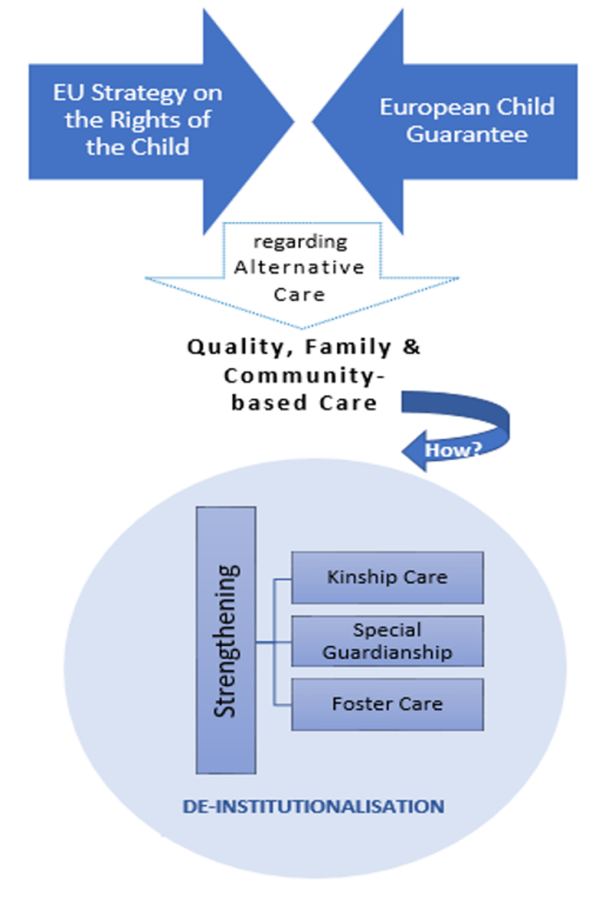
https://eurofamnet.eu
Notes:
Understanding alternative care
With respect to the setting where the alternative care is provided, the Guidelines for the Alternative Care of Children acknowledge in guideline 53, priority to family and community-based care [7].
In family-based care, an existing family is the care provider, such as in: (i) kinship care—within the child’s extended family or another carer close to the family and known to the child; (ii) foster care—within accredited couples or individuals in their own homes; or (iii) other family-based care.
Cantwell and colleagues [6] specify that the other family-based care includes settings where a family plays a care role identical to foster care but does not function within the foster care service. Families who act like guardians for children with long-term alternative care needs are examples of other family-based care. In a complementary way, community-based care refers to the idea that the child lives alongside other people and the community is involved in the process of the child’s recovery [8]. The effects of growing up in a family environment on a child’s life are widely recognized [9,10,11,12,13], centred on the possibility of achieving a sense of belonging, a family model, long term relationships and attachment, educational and labour support as well as a social life.

Slide 16
Part 3-Public social services provide a wide variety of family and parenting support mechanisms
https://eurofamnet.eu
Amongst the social support the most important are:
from early childcare to health prevention and health promotion in the early years to
“progressive universalism” –when needs are stronger, the provision of services is also stronger
benefits, and targeted measures (such as free education materials, free school meals and free access to leisure and culture).
Preventive measures
Notes:
The overall picture is that public social services in Europe provide a wide variety of family
and parenting support mechanisms –from early childcare to health prevention and health
promotion measures in the early years to rights, money and housing advice. Other forms of
support comprise pre and post-natal parental support, parents’ communication and
relationship skills and specific support for some families –mono-parental families and those
with economic difficulties. However, ESN members have noted difficulties in delivering
comprehensive and coordinated family support with all sectors involved in joint planning and
delivery. Furthermore, the threat of public spending cuts that, due to the crisis, have been
affecting most preventive services
In almost 80% of the 17 countries represented in the survey, parenting support1 services are
foreseen by the legislation. According to most responses (almost 74%), parenting support
services are provided in kind, that is to say, through training parents on their resources and
competences. According to 72% of respondents, these services are targeted at those who
need them more, such as disadvantaged and poor families. In connection with this, almost
1 According to the following definition of parenting support services by Daly (2012), parenting support
services must fulfil 3 conditions:
a. Parents are the first line target and focus on their parenting role
b. Support provide is a service in kind (cash excluded)
c. Focus on parents’ resources and competences
3
90% of ESN members who answered the survey responded that parenting support
programmes take into account that poverty can pose a stress on parenting.
Amongst the support services that public services across Europe provide for disadvantaged
families, the three most important forms of support are: early child care, universal child
benefits, and targeted measures (such as free education materials, free school meals and
free access to leisure and culture). In the area of prevention, ESN members who are
regional authorities also design preventive health care and health promotion programmes.
The provision of parenting services in most countries is designed and planned based on an
evaluation. Soren Frost, Head of Social Innovation at the city of Aarhus (Denmark),
confirms that families are assessed by professionals working in social services, and a family
action plan is drawn up stating the responsibilities and actions of family and social services.

Slide 17
Reflections the Family Support –the workforce behind
https://eurofamnet.eu
Fragmentation of services affect not only vulnerable families but all families
Complex situations requires joined up approaches:
  of different services ( care, education) horizontal,
  between age related services: transition between (home) and services- vertical,
  of different level of public governance (local, regional, and national), horizontal and vertical
Specialist social services in the field of child protection – in cooperation with other statutory services, such as health, education and the police – should always undertake a multidisciplinary assessment of the family’s situation, parenting skills, their impact on the child and the potential threat to the child.
Notes:
The role of local authorities
Legislation in several of the countries that have been analysed sets out the specific
responsibilities of local authorities to assess the needs of children and young people and
to look after them. Specialist social services in the field of child protection – in cooperation
with other statutory services, such as health, education and the police – undertake a
multidisciplinary assessment of the family’s situation, parenting skills, their impact on the
child and the potential threat to the child. In all countries analysed, child protection services
(at different government levels) may implement measures around family support, financial
benefits, parental support, family mediation and personalised work with children and families.
Child protection services may also apply to the courts for a number of different orders about
the type of care necessary and parental and relatives’ contact with the children. These orders
may involve a supervision order, involving the child being visited and monitored in their own
homes, or a consensual or compulsory order involving the child being taken into care.

Slide 18
Reflections the Family Support –the workforce behind
https://eurofamnet.eu
Design services to:
    Working with families (Child protection services (at different government levels) should implement measures around family support, financial benefits, parental support, family mediation and personalised work with children and families)
    With vulnerable children
    In partnership ‘the coordination of different services is particularly necessary to help children escape from poverty and social exclusion.
    Working for excellence (It is necessary to ensure the quality of services, and in order to do so, needs assessment, performance management and cost effectiveness should be considered.)
Address the shortage in the workforce and provide relevant training for all the professionals involved.
Harmonization of the policies
Notes:
The role of local authorities
Legislation in several of the countries that have been analysed sets out the specific
responsibilities of local authorities to assess the needs of children and young people and
to look after them. Specialist social services in the field of child protection – in cooperation
with other statutory services, such as health, education and the police – undertake a
multidisciplinary assessment of the family’s situation, parenting skills, their impact on the
child and the potential threat to the child. In all countries analysed, child protection services
(at different government levels) may implement measures around family support, financial
benefits, parental support, family mediation and personalised work with children and families.
Child protection services may also apply to the courts for a number of different orders about
the type of care necessary and parental and relatives’ contact with the children. These orders
may involve a supervision order, involving the child being visited and monitored in their own
homes, or a consensual or compulsory order involving the child being taken into care.

Slide 19

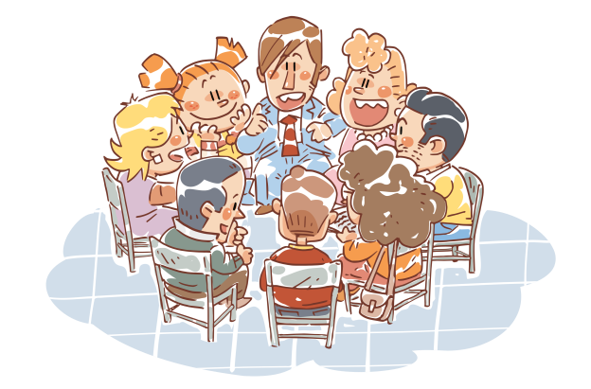


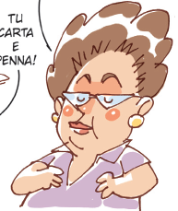


Integrated and shared assessment and care plan
Ecological and Multidimensional approach = sharing responsibilities
Parents’ & Children group
Social Worker – case manager
Family support/assistantHome care worker
TARGET FAMILY
Family /Natural Helpers
School /Teachers
Psychologist

Slide 20
ESN’s current work on the workforce
https://eurofamnet.eu
Side by Side – ESN’s new project to tackle violence against children
  Study visit in Ireland
  Tusla ( Child and Family Agency) has developed Meitheal as a national early intervention practice model to ensure that the needs and strengths of children and their families are effectively identified, understood and responded to in a timely way so that children and families get the help and support needed to improve children’s outcomes and to realise their rights.
  Training needs assessment
SISSWEC project and EP roundtable on Investing in the Workforce of Social Services
Notes:
The study visit to Dublin, Ireland, will be hosted by Tusla - Child and Family Agency who will present the national Meitheal programme.
Tusla has developed Meitheal as a national early intervention practice model to ensure that the needs and strengths of children and their families are effectively identified, understood and responded to in a timely way so that children and families get the help and support needed to improve children’s outcomes and to realise their rights.
Meitheal’s main characteristics:
Meitheal is a case co-ordination process, facilitated by Tusla staff, for families with additional needs who require multi-agency intervention but who do not need a mandatory child protection response by the Social Work Department.
Practitioners in different agencies can use and lead on Meitheal so that they can communicate and work together more effectively to bring together a range of expertise, knowledge and skills to meet the needs of the child and family within their community.
The main focus of the Meitheal framework is on early intervention aiming to promote and protect the health, well-being and rights of all children, young people and their families. In addition, particular attention is given to those who are vulnerable or at risk of harm to try to prevent the need for a child protection response by Tusla.
The programme promotes positive parenting with families, which is non-violent, democratic and reciprocal; emphasises strong support, warmth and responsiveness and involves the child in decision making.
Suggested stakeholders for this study visit from our European partners are those involved in child protection and welfare policy and practice, particularly the interface between child protection and family support, prevention & early intervention.

Slide 21
Practices
Children First (Belgium)
Social workers are integrated into schools through the Children First practice in Ghent.
More comprehensive care for kids and families
Each school staff member has the authority to direct families to the PCSW worker.
Collaborating with schools results in faster and more lasting solutions and allows for the establishment of family-centred integrated care systems
Mothers 4 Mothers (Germany)
In Offenbach County, 16% of children lack access to childcare, and many migrant women struggle to secure their first job.
Mums@Work project aims to provide social and educational support for young migrant mothers and encourage their successful integration into society
The project facilitates young immigrant moms’ access to the labour market and helps them earn a degree to lower or eliminate poverty.
Supporting parents give their children the best start in life (Ireland)
Home visits and programs for first-time parents
Parental Objectives: Greater parental efficacy and knowledge of child development • Better and more stable relationships with their children
Objectives for Children: Improved child-parent attachment and bonding • Improved development outcomes in terms of physical, emotional, and mental health

Slide 22
Best Practices
The Best for Every Child! (Sweden)
Adopting a child-focused approach to understanding the well-being and needs of a child.
Based on an understanding of the well-being of a child in their current situation and on tackling needs early
Prioritizing the interests of the child over the interests of the service providers.
The Looked After Children Service (Malta)
Establish individual care plan to meet the child's needs
Focus on stability and independence for the child
The goal is to see children return to family homes if in their best interest
Provide continuous support and information for an independent and stable life in society
Early Detection and Intervention for Children (Spain)
Local networks of specialists in education, health, and social services will collaborate to identify at-risk children earlier and offer more comprehensive help.
Goals include helping children access nursery schools and early childhood services, improving parents' competency, promoting children's growth, and encouraging diverse community environments.

Slide 23

click here to register for the 2023 edition
Contact Person: Rioghnach Hyland, Junior Events Officer, at: conference@esn-eu.org

Slide 24
THANK YOU!
https://eurofamnet.eu
Email: elona.bokshi@esn-eu.org

